Slide 1
Intro to Engineering Biology
Notes:
https://roadmap.ebrc.org/2019-roadmap/

Slide 2
Goals of this lecture
You will be able to answer:
What is synthetic/engineering biology?
How can I Design, Build, Test, and Learn from biological systems?
What are the Core Tools of engineering biology?
How and where can engineering biology be applied to positively impact society?
You will have:
Planned a design cycle to approach a current problem
Learned about engineering biology tools that can help you develop your idea
Discovered the many sectors that engineering biology can positively impact
Recommended knowledge: “biology 101” level, generally how DNA & cells work

Slide 3
Table of Contents
Concept 1-1: What is Synthetic (or Engineering) Biology?
Slides 4-23 - link
Concept 1-2: Engineering Biology Roadmap & the DBTL Cycle
Slides 24-28 - link
Concept 1-3: Core Tools for Engineering Biology
Part 1: Engineering DNA & Biomolecules
Slides 29-48 - link
Concept 1-4: Core Tools for Engineering Biology
Part 2: Engineering Hosts and Data Science
Slides 49-73 - link
Concept 1-5: Impacts & Applications
Slides 74-85 - link

Slide 4
Concept 1-1
What is Synthetic, or Engineering, Biology?

Slide 5
What is Engineering Biology?
Engineering Biology (a broader term for Synthetic Biology) is the design and construction of new biological entities such as enzymes, genetic circuits, and cells or the redesign of existing biological systems.
Engineering biology builds on the advances in molecular, cell, and systems biology and seeks to transform biology in the same way that synthesis transformed chemistry and integrated circuit design transformed computing.
The element that distinguishes engineering biology from traditional molecular and cellular biology is the focus on the design and construction of core components (e.g., parts of enzymes, genetic circuits, metabolic pathways) that can be modeled, understood, and tuned to meet specific performance criteria, and the assembly of these smaller parts and devices into larger integrated systems to solve specific problems.
Unlike many other areas of engineering, biology is incredibly non-linear and less predictable, and there is less knowledge of the parts and how they interact.
Hence, the overwhelming physical details of natural biology (gene sequences, protein properties, biological systems) must be organized and recast via a set of design rules that hide information and manage complexity, thereby enabling the engineering of many-component integrated biological systems.
It is only when this is accomplished that designs of significant scale will be possible.
Notes:
https://ebrc.org/what-is-synbio/
Engineering Biology – The design and construction of new biological entities such as enzymes, genetic circuits, and cells or the redesign of existing biological systems. Engineering biology builds on the advances in molecular, cell, and systems biology and seeks to transform biology in the same way that synthesis transformed chemistry and integrated circuit design transformed computing. The element that distinguishes engineering biology from traditional molecular and cellular biology is the focus on the design and construction of core components (e.g., parts of enzymes, genetic circuits, metabolic pathways) that can be modeled, understood, and tuned to meet specific performance criteria, and the assembly of these smaller parts and devices into larger integrated systems to solve specific problems. Unlike many other areas of engineering, biology is incredibly non-linear and less predictable, and there is less knowledge of the parts and how they interact. Hence, the overwhelming physical details of natural biology (gene sequences, protein properties, biological systems) must be organized and recast via a set of design rules that hide information and manage complexity, thereby enabling the engineering of many-component integrated biological systems. It is only when this is accomplished that designs of significant scale will be possible. EBRC (and thus, this roadmap) uses Engineering Biology synonymous with Synthetic Biology.
https://roadmap.ebrc.org/materials-glossary/

Slide 6
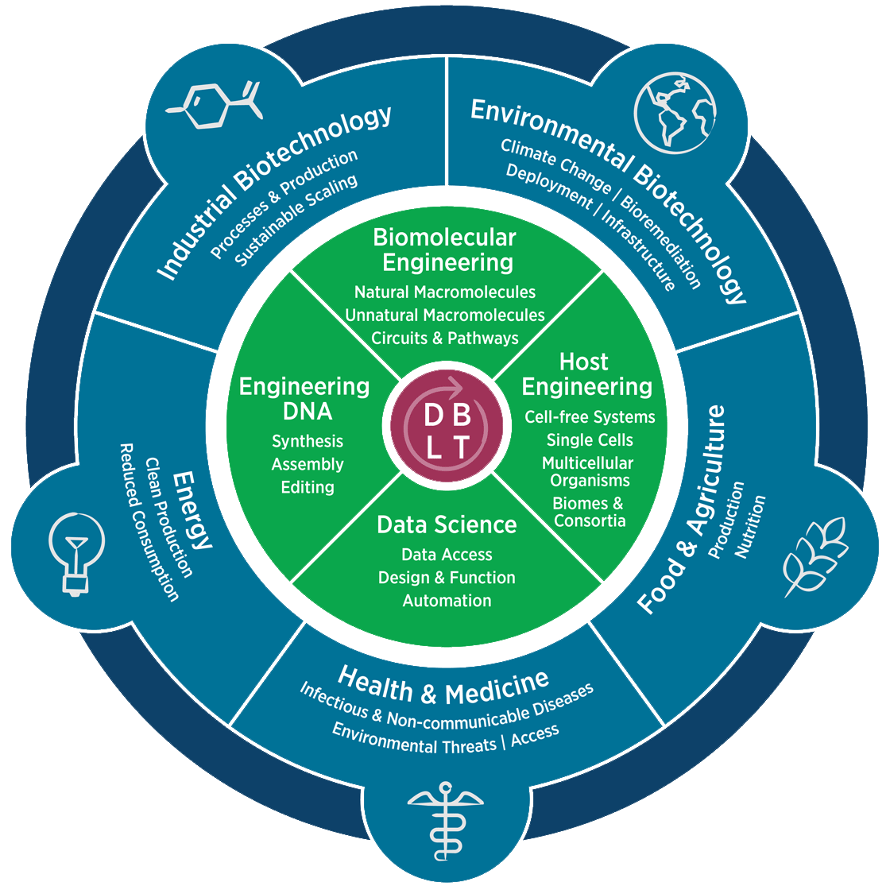
What is Engineering Biology?
The goal: “engineer living cells to do something useful; for example, treat a disease, sense a toxic compound in the environment, or produce a valuable drug.” (BioBuilder)
Engineering Biology Research Consortium (2019). Engineering Biology: A Research Roadmap for the Next-Generation Bioeconomy. Retrieved from http://roadmap.ebrc.org. doi: 10.25498/E4159B.

Slide 7
What is Engineering Biology?
Example: using industrial biotechnology to treat a disease
Engineering Biology Research Consortium (2019). Engineering Biology: A Research Roadmap for the Next-Generation Bioeconomy. Retrieved from http://roadmap.ebrc.org. doi: 10.25498/E4159B.

Slide 8
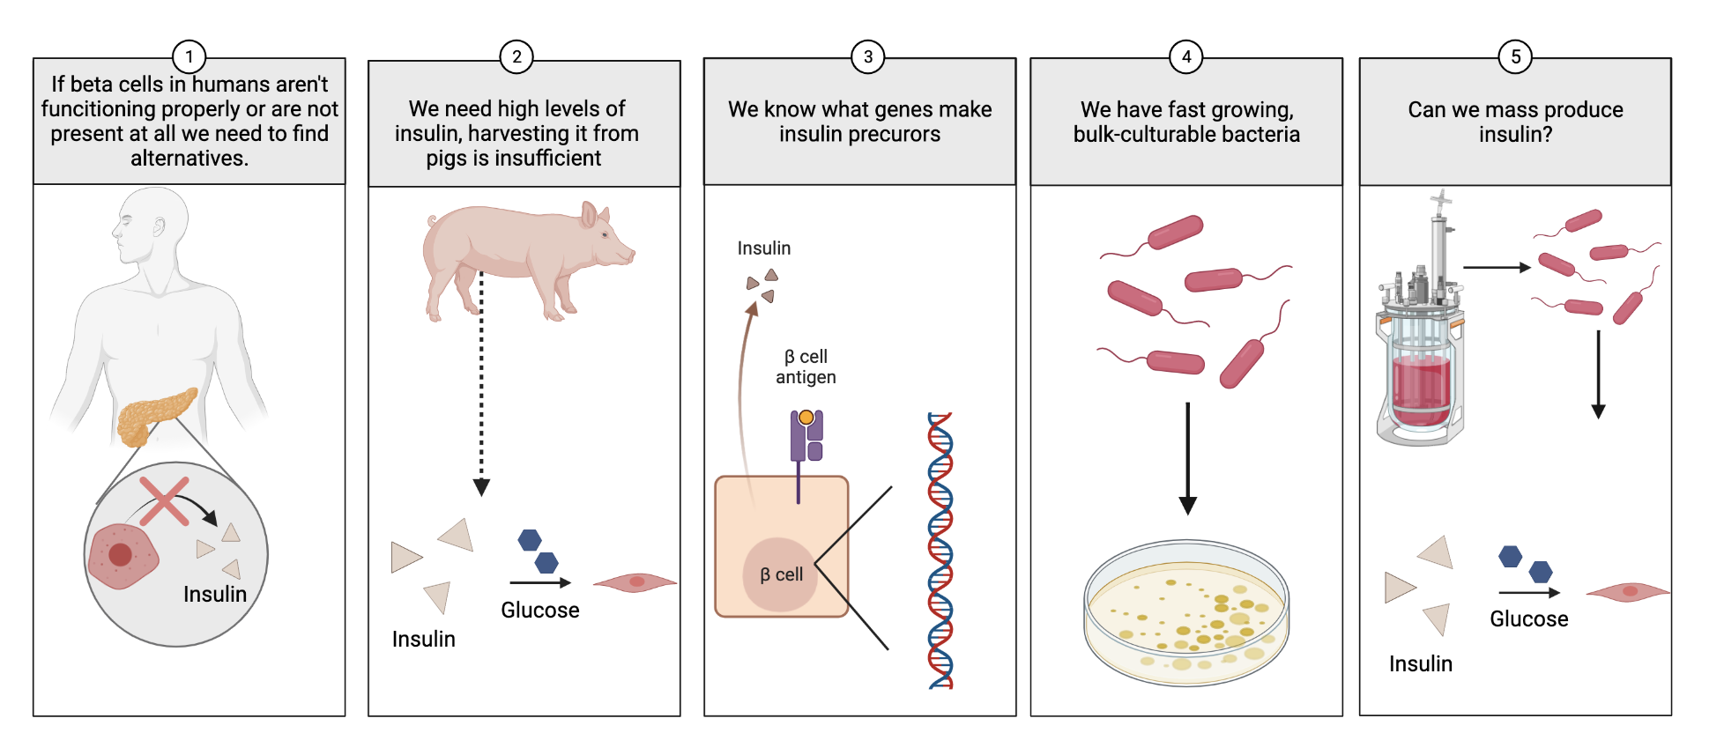
Industrial: Bacterial production of insulin
Mona Dabbas & Javin Oza, California Polytechnic State University. Created with Biorender.com.

Slide 9
Industrial: Bacterial production of insulin
What tools do we need?
Insulin precursor genes
Genetic parts for gene expression in E. coli
Way to assemble these genetic parts
The E. coli cells themselves
Way to get the DNA into the cells
Way to harvest insulin from bacteria
Way to measure insulin production

Slide 10
Industrial: Bacterial production of insulin
What steps do we need to take?
Design a genetic circuit that will produce insulin in E. coli
Build the genetic circuit, and put it into bacteria
Test how much insulin is made
Learn what did/didn’t work, change design accordingly

Slide 11
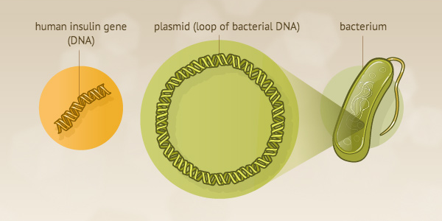
Industrial: Bacterial production of insulin
NIH. From DNA to Beer: Harnessing Nature in Medicine & Industry. 2013.
Notes:
Graphic courtesy of the National Library of Medicine.
https://www.nlm.nih.gov/exhibition/fromdnatobeer/exhibition-interactive/recombinant-DNA/recombinant-dna-technology-alternative.html

Slide 12
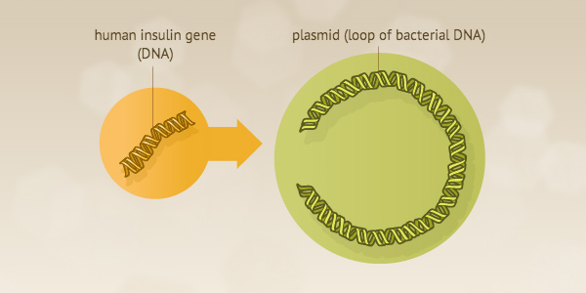
Industrial: Bacterial production of insulin
NIH. From DNA to Beer: Harnessing Nature in Medicine & Industry. 2013.
Notes:
Graphic courtesy of the National Library of Medicine.
https://www.nlm.nih.gov/exhibition/fromdnatobeer/exhibition-interactive/recombinant-DNA/recombinant-dna-technology-alternative.html

Slide 13
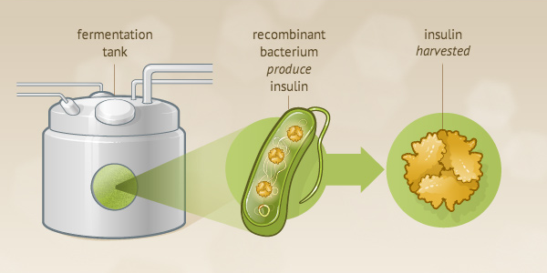
Industrial: Bacterial production of insulin
NIH. From DNA to Beer: Harnessing Nature in Medicine & Industry. 2013.
Notes:
Graphic courtesy of the National Library of Medicine.
https://www.nlm.nih.gov/exhibition/fromdnatobeer/exhibition-interactive/recombinant-DNA/recombinant-dna-technology-alternative.html

Slide 14
Industrial: Bacterial production of insulin
NIH. From DNA to Beer: Harnessing Nature in Medicine & Industry. 2013.
Notes:
Graphic courtesy of the National Library of Medicine.
https://www.nlm.nih.gov/exhibition/fromdnatobeer/exhibition-interactive/recombinant-DNA/recombinant-dna-technology-alternative.html

Slide 15
What is Engineering Biology?
Example: use genetic circuits to mitigate an environmental pest
Engineering Biology Research Consortium (2019). Engineering Biology: A Research Roadmap for the Next-Generation Bioeconomy. Retrieved from http://roadmap.ebrc.org. doi: 10.25498/E4159B.

Slide 16
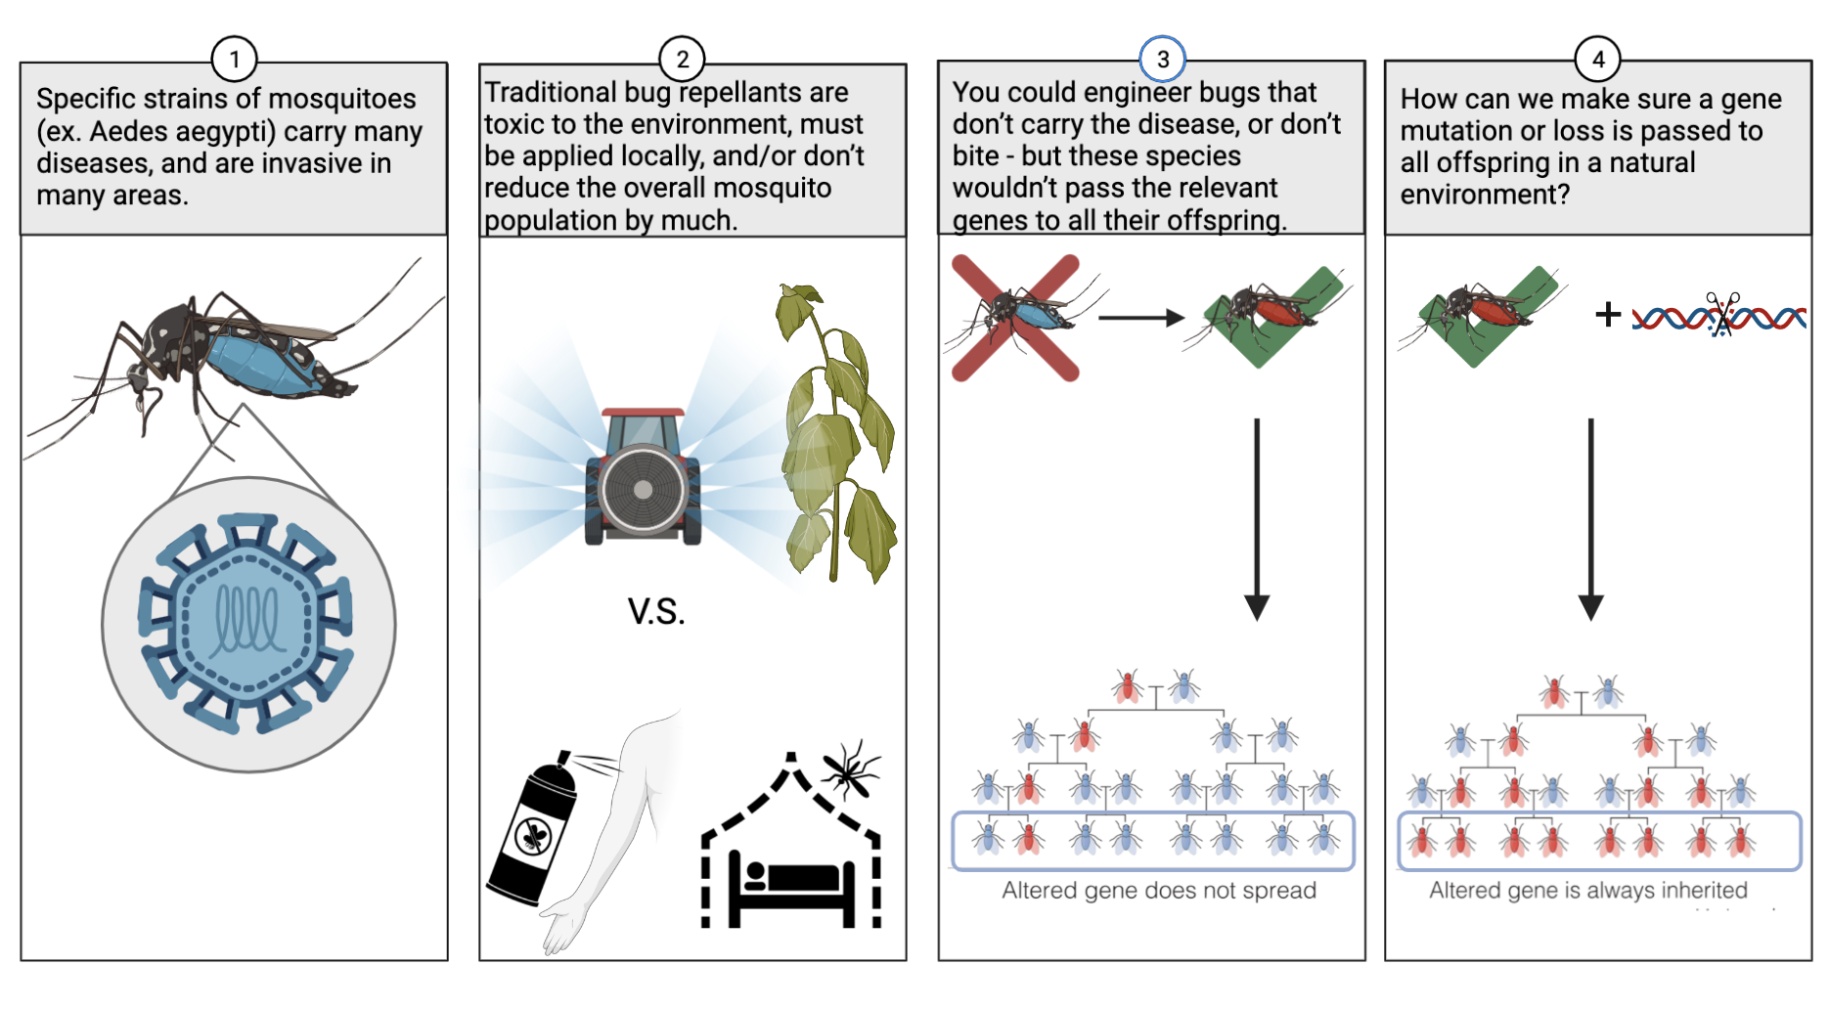
Environment: Gene drives limit mosquito populations
Marius Walter, “Gene Drive.”
Mona Dabbas & Javin Oza, California Polytechnic State University. Created with Biorender.com.

Slide 17
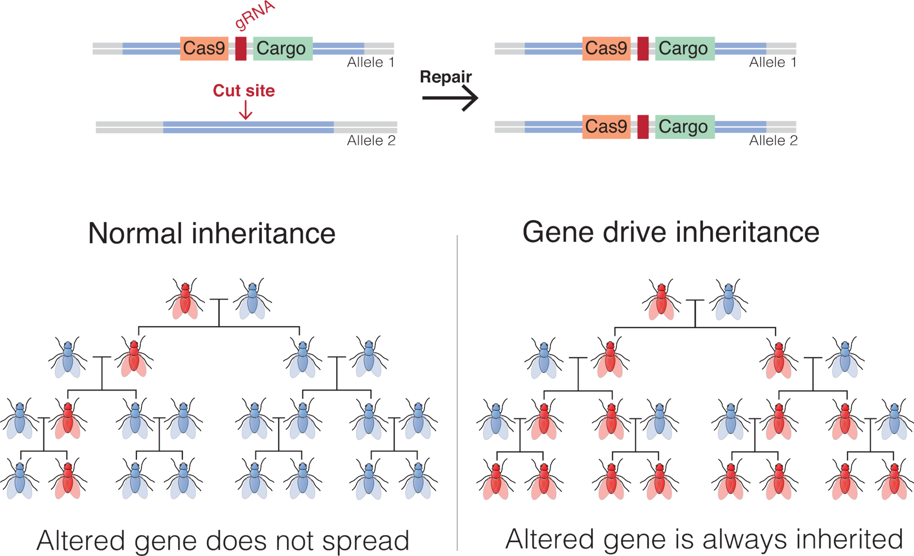
Environment: Gene drives limit mosquito populations
Marius Walter, “Gene Drive.”
Notes:
https://en.wikipedia.org/wiki/Gene_drive#/media/File:Gene_Drive.png

Slide 18
Environment: Gene drives limit mosquito populations
What tools do we need?
Gene target to “knock out” or edit
Genetic tool that will ensure these edits in all offspring
Way to edit genes in mosquitoes
Way to measure phenotypic changes from gene edits
LOTS of safety testing strategies
Notes:
https://en.wikipedia.org/wiki/Gene_drive#/media/File:Gene_Drive.png

Slide 19
Environment: Gene drives limit mosquito populations
What steps do we take?
Design a system that will knock out the selected gene in all offspring
Build mosquitoes that carry this system
Test the safety, efficacy, and spread of this gene system
Learn by assessing how this impacts the mosquito population, overall environment, and disease spread
Notes:
https://en.wikipedia.org/wiki/Gene_drive#/media/File:Gene_Drive.png

Slide 20
Environment: Gene drives limit mosquito populations
Marius Walter, “Gene Drive.”
Notes:
https://en.wikipedia.org/wiki/Gene_drive#/media/File:Gene_Drive.png

Slide 21
Environment: Bioethics of gene drives
Gene Drives:
What are potential safety concerns of gene drives?
Who should decide when and where gene drives are used?
How can gene drives be contained, or “undone” after use?
Core Principles:
Use engineering biology to benefit the world
Weigh benefits of research against potential harms
Incorporate justice into all aspects of engineering biology
Share research
Protect the freedoms of individuals and researchers
Support open communication between researchers and other stakeholders
Mackelprang, R., et al. (2021). “Guiding ethical principles in engineering biology research.”

Slide 22
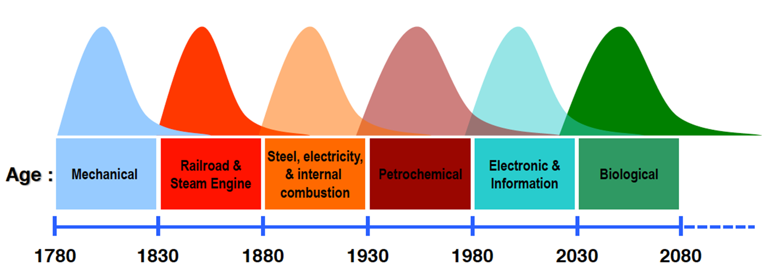
Engineering biology as the next Kondratiev Wave
Michael Jewett, Northwestern University.

Slide 23
What is Engineering Biology?
Engineering Biology (aka Synthetic Biology) is the design and construction of new biological entities such as enzymes, genetic circuits, and cells or the redesign of existing biological systems.
Engineering biology builds on the advances in molecular, cell, and systems biology and seeks to transform biology in the same way that synthesis transformed chemistry and integrated circuit design transformed computing.
The element that distinguishes engineering biology from traditional molecular and cellular biology is the focus on the design and construction of core components (e.g., parts of enzymes, genetic circuits, metabolic pathways) that can be modeled, understood, and tuned to meet specific performance criteria, and the assembly of these smaller parts and devices into larger integrated systems to solve specific problems.
Unlike many other areas of engineering, biology is incredibly non-linear and less predictable, and there is less knowledge of the parts and how they interact.
Hence, the overwhelming physical details of natural biology (gene sequences, protein properties, biological systems) must be organized and recast via a set of design rules that hide information and manage complexity, thereby enabling the engineering of many-component integrated biological systems.
It is only when this is accomplished that designs of significant scale will be possible.
Notes:
https://ebrc.org/what-is-synbio/
Engineering Biology – The design and construction of new biological entities such as enzymes, genetic circuits, and cells or the redesign of existing biological systems. Engineering biology builds on the advances in molecular, cell, and systems biology and seeks to transform biology in the same way that synthesis transformed chemistry and integrated circuit design transformed computing. The element that distinguishes engineering biology from traditional molecular and cellular biology is the focus on the design and construction of core components (e.g., parts of enzymes, genetic circuits, metabolic pathways) that can be modeled, understood, and tuned to meet specific performance criteria, and the assembly of these smaller parts and devices into larger integrated systems to solve specific problems. Unlike many other areas of engineering, biology is incredibly non-linear and less predictable, and there is less knowledge of the parts and how they interact. Hence, the overwhelming physical details of natural biology (gene sequences, protein properties, biological systems) must be organized and recast via a set of design rules that hide information and manage complexity, thereby enabling the engineering of many-component integrated biological systems. It is only when this is accomplished that designs of significant scale will be possible. EBRC (and thus, this roadmap) uses Engineering Biology synonymous with Synthetic Biology.
https://roadmap.ebrc.org/materials-glossary/

Slide 24
Concept 1-2
Engineering Biology Roadmap
& the DBTL Cycle

Slide 25
Engineering Biology Roadmap
From a Design, Build, Test, Learn centered approach
Uses biological, engineering, and computational tools
To positively impact multiple sectors
Engineering Biology Research Consortium (2019). Engineering Biology: A Research Roadmap for the Next-Generation Bioeconomy. Retrieved from http://roadmap.ebrc.org. doi: 10.25498/E4159B.
Notes:
https://roadmap.ebrc.org/dbtl/

Slide 26
The DBTL Cycle
Design a biological circuit or system for a specific function using literature & computational tools.
Build your system by assembling, editing, and installing genetic parts.
Test system functionality using robust metrics & controls.
Learn from how the system (doesn’t) work to create new design rules, and share your knowledge.
Gray, P. et al. Synthetic Biology in Australia: An Outlook to 2030 (Australian Council of Learned Academies, 2018).
Notes:
Design/Build/Test/Learn graphic, with an example accompanying each step

Slide 27
DBTL: In Practice
Design by finding genes for human insulin precursors, and optimize/model E. coli expression.
Build gene sequence including insulin precursor genes though synthesis & assembly.
Test your circuit in cells by measuring for insulin precursor proteins chemically via an assay.
Learn how well your system works, and what optimization is necessary.
Gray, P. et al. Synthetic Biology in Australia: An Outlook to 2030 (Australian Council of Learned Academies, 2018).

Slide 28
DBTL: Exercise
Think about what an engineering biology solution would look like:
What would an initial design of the system look like?
What tools and knowledge would you need to build this?
How would you test whether your system worked?
What might you learn about the problem through testing your solution? What might be issues when developing your system?
And don’t get too bogged down in the details! We’ll go over more tools for each phase later.
Choose a technology or problem that is impactful to you.
Example ideas: trees with fireproof wood, drought-resistant cabbage, sustainable bioplastics, engineered probiotics for gut health, cell-free water quality sensors

Slide 29
Concept 1-3
Core Tools Part 1:
Engineering DNA,
Biomolecular Engineering

Slide 30
Core Tools for Engineering DNA
What are the current tools for engineering DNA?
Tools enabling a engineering DNA DBTL
Synthesis
Sequencing
Standardization
Assembly
Editing
Engineering Biology Research Consortium (2019). Engineering Biology: A Research Roadmap for the Next-Generation Bioeconomy. Retrieved from http://roadmap.ebrc.org. doi: 10.25498/E4159B.

Slide 31
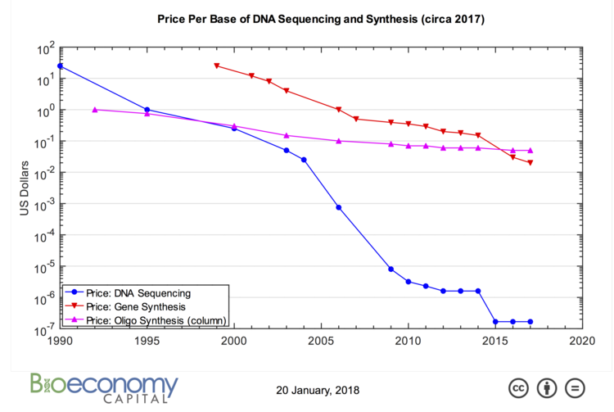
Engineering DNA:
Synthesis and Sequencing
Gene synthesis and sequencing are becoming exponentially cheaper
Entire genes can be synthesized in a matter of hours-days at relatively low cost
This rapid reduction in cost and time for sequencing and synthesis allows large-scale testing of new genetic constructs
Carlson, R. Synthesis. “On DNA and transistors.”
Notes:
Synbiobeta: http://www.synthesis.cc/synthesis/category/Carlson+Curves

Slide 32
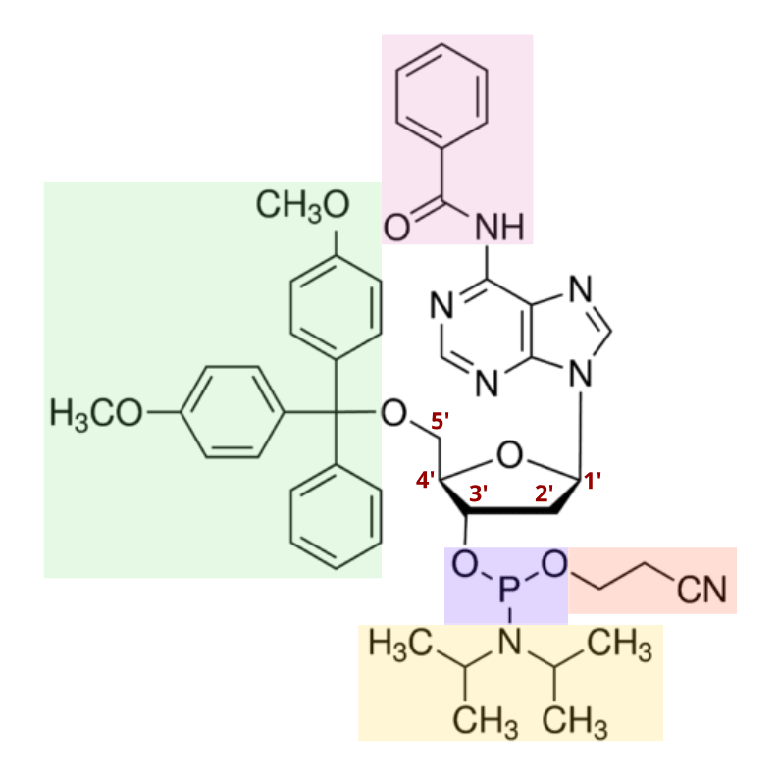
Engineering DNA:
How single-stranded DNA is synthesized
Phosphoramidite chemical synthesis
Pioneered by Marvin Caruthers in 1983 at CU-Boulder
Single-stranded DNA oligos are synthesized using solid-phase chemistry performed on solid supports
Controlled pore glass beads (IDT, GenScript)
Silicon chip (Twist, Agilent)
Twist Bioscience.
Twist Bioscience.
Notes:
First phosphoramidite paper: doi.org/10.1016/S0040-4039(00)81376-3
Left figure: https://www.twistbioscience.com/blog/science/simple-guide-phosphoramidite-chemistry-and-how-it-fits-twist-biosciences-commercial
Right lego figure: https://www.twistbioscience.com/technology

Slide 33
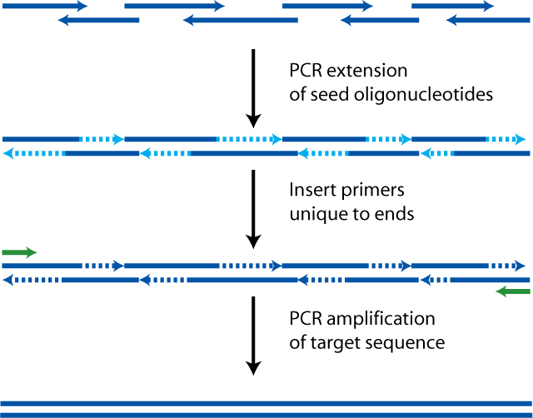
Engineering DNA:
How double-stranded genes are synthesized
Larger genes can be constructed using polymerase chain assembly of shorter synthetic fragments
Short single-stranded oligos are stitched together and filled in using DNA polymerase and PCR to produce double-stranded genes
Dhorspool, “PCA polymerase cycling assembly.”
Notes:
Image credit: PCA polymerase cycling assembly - Polymerase cycling assembly - Wikipedia

Slide 34
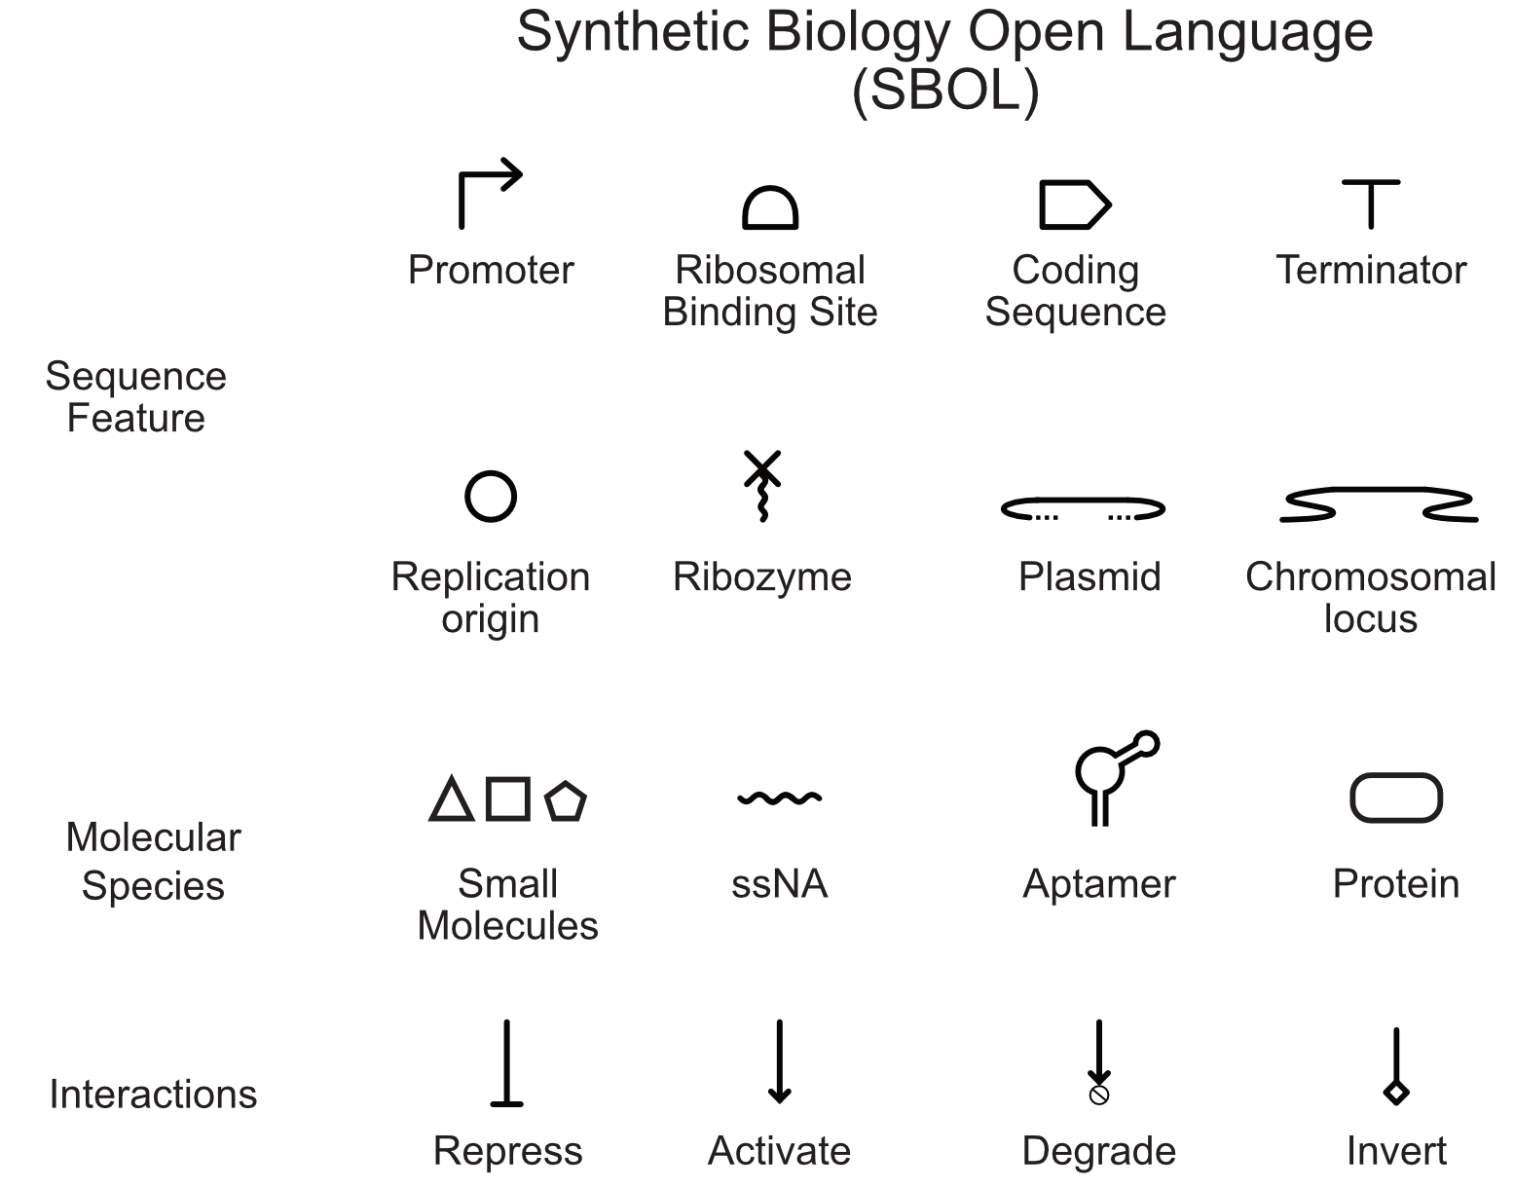
Engineering DNA:
Standardized depiction of gene circuits
Engineering Biology often requires descriptions of the DNA sequences used and how they function
With the wealth of easy to synthesize DNA parts how do we communicate what pieces of synthetic DNA do?
The Synthetic Biology Open Language (SBOL) is a framework for describing synthetic DNA sequences and their functional relationships
Joshua Atkinson, University of Southern California

Slide 35
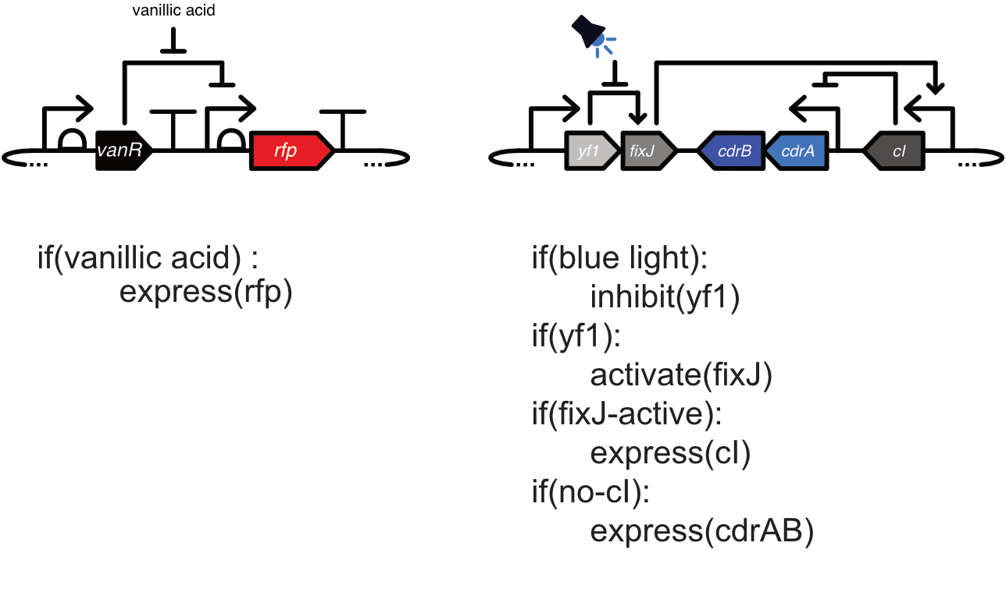
Engineering DNA:
Examples of SBOL based diagrams
On the left is a plasmid for chemically-inducible expression red fluorescent protein
On the right is a plasmid for the light-inducible expression of the adhesins CdrAB
Both of these plasmids express components that control the expression of other components
The logical interpretations of the diagrams are listed below the image.
Joshua Atkinson, University of Southern California
Notes:
Image credit:

Slide 36
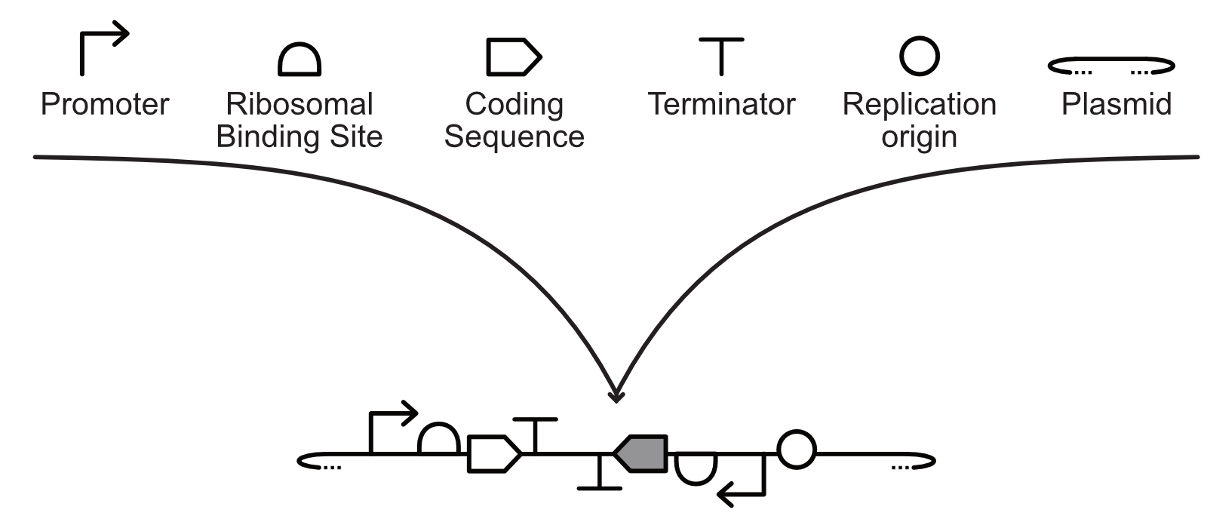
Engineering DNA:
DNA assembly methods
There are a range of techniques for assembling genetic parts into genetic constructs and plasmids in vitro
Classical assembly (restriction enzyme + ligation)
Golden gate assembly
Gibson assembly
Joshua Atkinson, University of Southern California
Notes:
Image credit: Joshua Atkinson

Slide 37
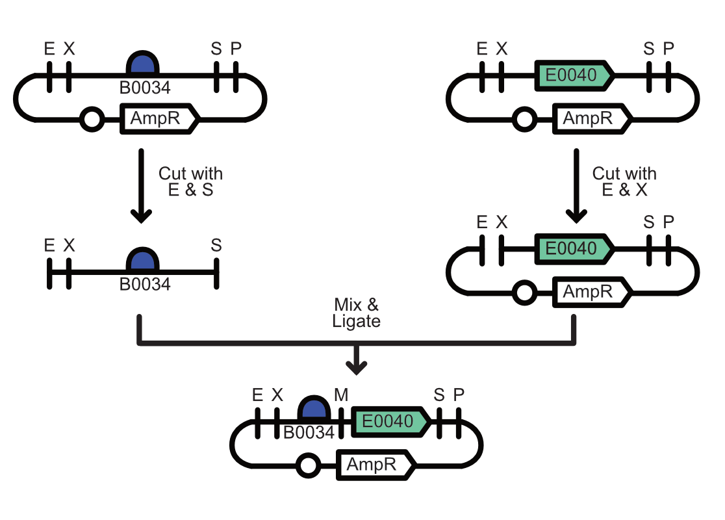
Engineering DNA:
DNA assembly using Classical Assembly
This approach has been used for vector cloning in molecular biology since the 1970s (Cohen SN, et al. PNAS (1973)70(11):3240-4)
Type II restriction enzymes (RE) cut dsDNA typically within 6 bp palindromic sequences leaving 4 bp ssDNA overhangs
Complementary overhangs can be ligated together using a DNA ligase
This is also used in BioBrick cloning (EcoRI/XbaI, SpeI/PstI)
Leaves behind RE site scars between DNA parts
BioBrick Cloning using Classical Assembly
Joshua Atkinson, University of Southern California
Notes:
Image credit: Joshua Atkinson

Slide 38
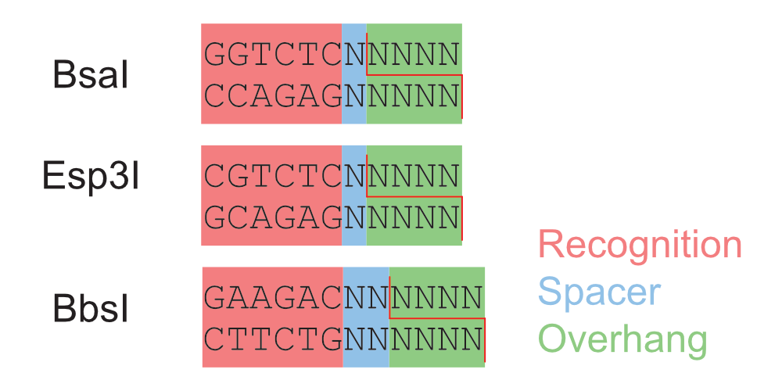
Engineering DNA:
Multipart assembly using Golden Gate
To overcome the limitation of scar sites and to improve ligation efficiency Golden Gate cloning was developed in 2008 (Engler C, et al., PLoS One (2008) 3(11):e3647)
Type IIs restriction enzymes bind recognition sites, but cut outside of them
This allows for the generation of programmable overhangs that eliminate scare sites between DNA parts and do not reform the original cut site improving efficiency
Joshua Atkinson, University of Southern California
Notes:
Image credit: Joshua Atkinson

Slide 39
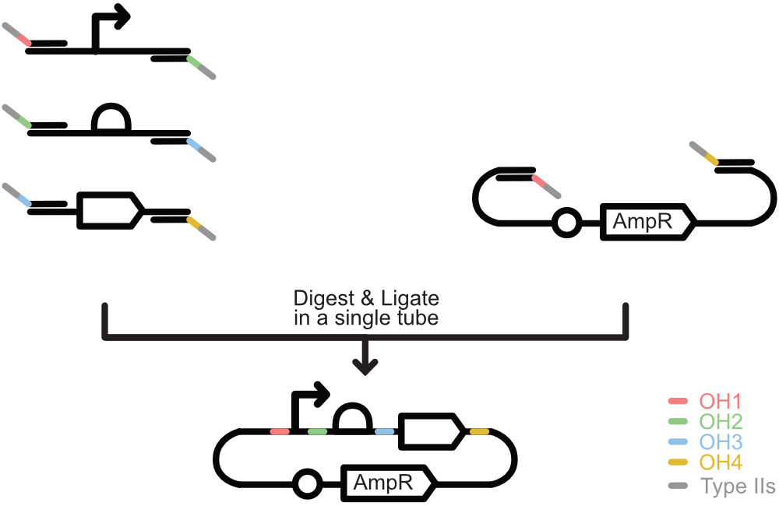
Engineering DNA:
Multipart assembly using Golden Gate
Golden Gate assembly can be easily achieved using PCR with primers that introduce Type IIs restriction sites (e.g., BsaI, BbsI, Esp3I) that flank parts
Parts have unique complementary overhangs (OH1-4) that guide their assembly in the correct order
This can be scaled to >50 fragments allowing for high-throughput multipart assembly
Joshua Atkinson, University of Southern California
Notes:
Image credit: Joshua Atkinson

Slide 40
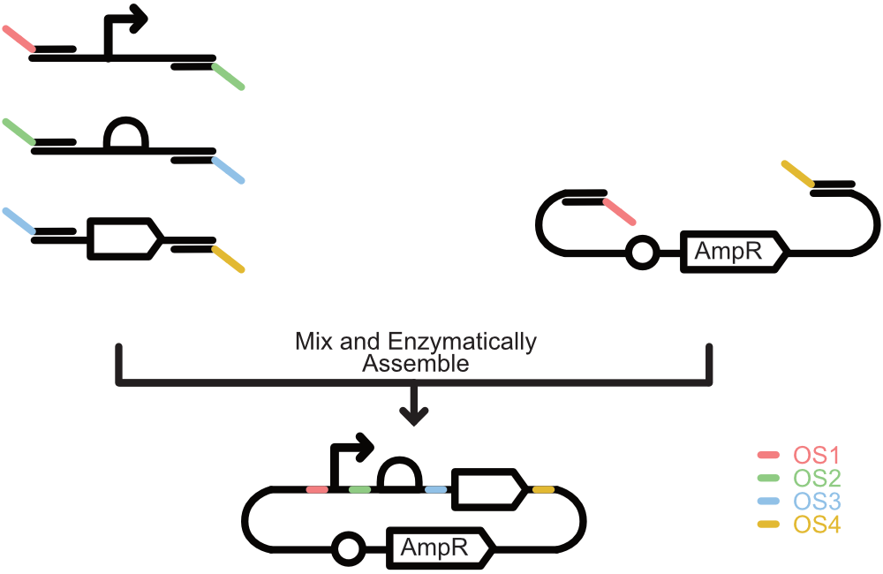
Engineering DNA:
Multipart assembly using Gibson Assembly
To facilitate large-scale DNA assembly in 2009 Gibson DNA assembly was developed (Gibson D.G., et al., Nat. Methods (2009) 6(5)343-345)
This method utilizes in vitro homologous recombination facilitated by T5 exonuclease, Phusion polymerase, and Taq ligase
This requires the introduction of ~40-60 bp of overlapping sequences (OS) on the ends of the sequences to guide DNA parts to assemble
Has been scaled to assembly of entire genomes
Joshua Atkinson, University of Southern California
Notes:
Image credit: Joshua Atkinson
https://www.nature.com/articles/d41586-020-00511-9

Slide 41
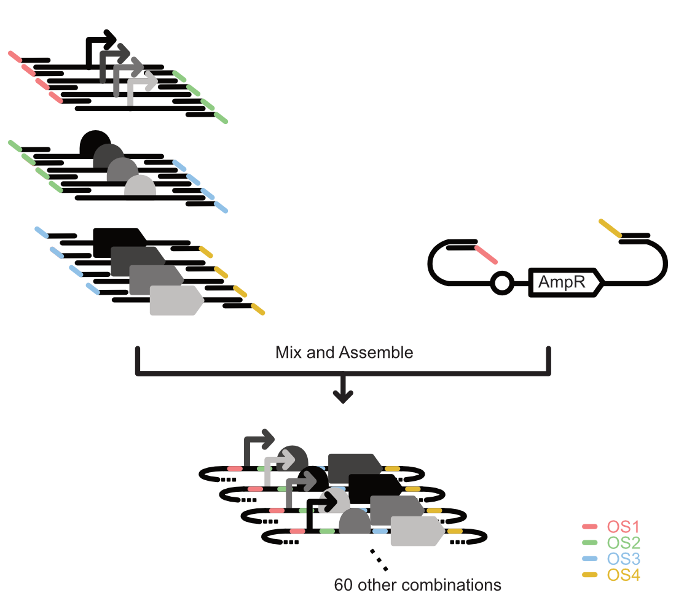
Engineering DNA:
High-throughput combinatorial DNA assembly
The use of multi-part DNA assembly techniques enables the construction of large scale combinatorial libraries of DNA sequences
This is useful when optimizing expression of multiple genes at once allowing for rapid exploration of parameter spaces
This approach is often used for enhancing yield of metabolic pathways and engineering proteins
Joshua Atkinson, University of Southern California
Notes:
Image credit: Joshua Atkinson
https://www.nature.com/articles/d41586-020-00511-9

Slide 42
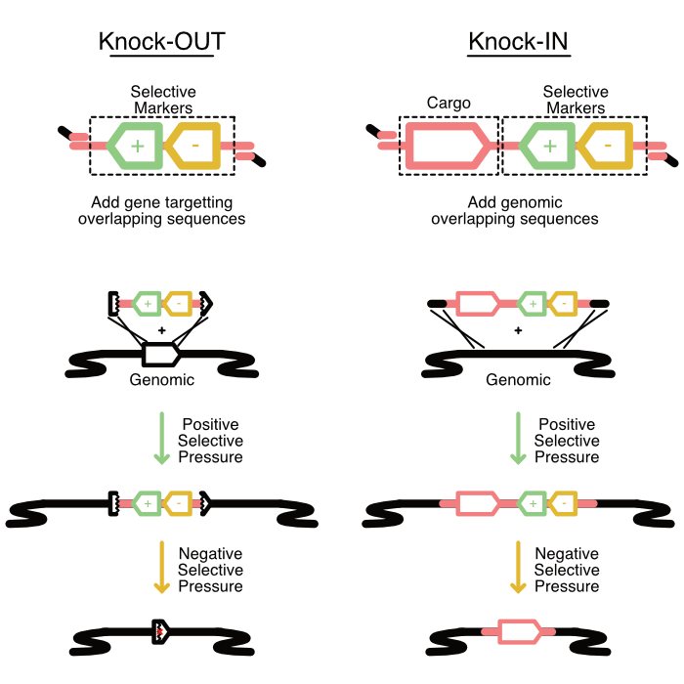
Engineering DNA:
Editing Genomes by Knocking-IN or Knocking-OUT
Genomes can also be engineered
One strategy for genome editing is to leverage homologous recombination to delete genes (Knock-OUT) or to introduce entirely new sequences (Knock-IN)
This can be achieved by introducing selective markers to select for cells within populations that have either gained (positive selection) or lost the engineered DNA (negative selection)
Joshua Atkinson, University of Southern California
Notes:
Image credit: Joshua Atkinson

Slide 43
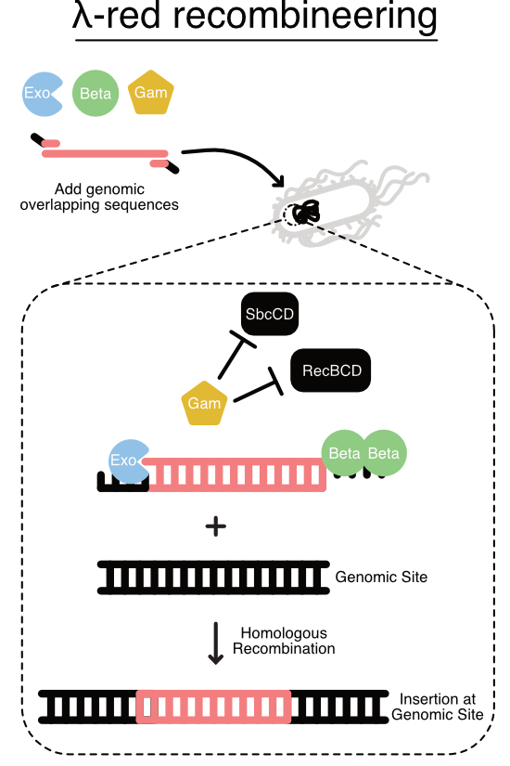
Engineering DNA:
Using Recombineering to edit genomes
Viral mechanisms for DNA integration have been co-opted to increase genomic engineering efficiency
One approach, called ‘recombineering’, leverages the E. coli lambda prophage (Yu D, et al., PNAS (2000), 97(11):5978-5983)
Prophage proteins Exo, Beta, and Gam improve integration of DNA harboring genomic overlapping sequences by chewing back dsDNA to generate ssDNA, protecting ssDNA from degradation, and blocking host exonucleases, respectively
Joshua Atkinson, University of Southern California
Notes:
Image credit: Joshua Atkinson

Slide 44
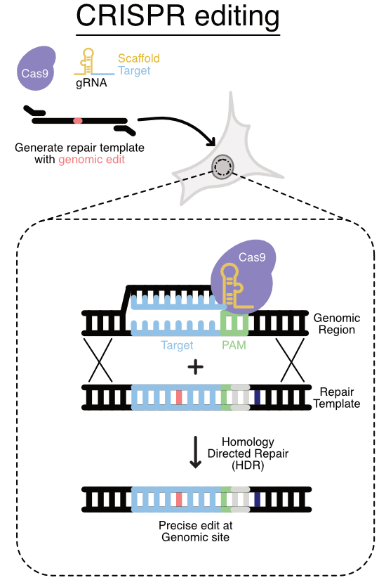
Engineering DNA:
Using CRISPR-Cas9 to make precise genome edits
Adaptive-immunity mechanisms from bacteria have been co-opted to enable precise genomic edits
Clustered Regularly Interspaced Short Palindromic (CRISPR) systems from diverse bacteria have enabled a revolution in genomic editing
Cas9 is one of the most widely used CRISPR systems used for genome engineering (Jinek M., et al., Science (2012) 337(6096):816-821)
Cas9 is an RNA-guided endonuclease that makes double-stranded breaks at specific sites.
Guide RNAs (gRNA) can be engineered target Cas9 to specific DNA sequences that precede PAM sites (NGG).
One way to make genomic edits leverages homology directed repair to integrate an engineered repair template that eliminates the PAM site and subsequent retargeting.
Joshua Atkinson, University of Southern California
Notes:
Image credit: Joshua Atkinson

Slide 45
Core Tools for Biomolecular Engineering
What are our current tools for Biomolecular Engineering?
Tools enable a Biomolecular Engineering DBTL
Comprehensive Mutagenesis libraries
Functional Screens
Functional Selections
Directed Evolution
Engineering Biology Research Consortium (2019). Engineering Biology: A Research Roadmap for the Next-Generation Bioeconomy. Retrieved from http://roadmap.ebrc.org. doi: 10.25498/E4159B.

Slide 46
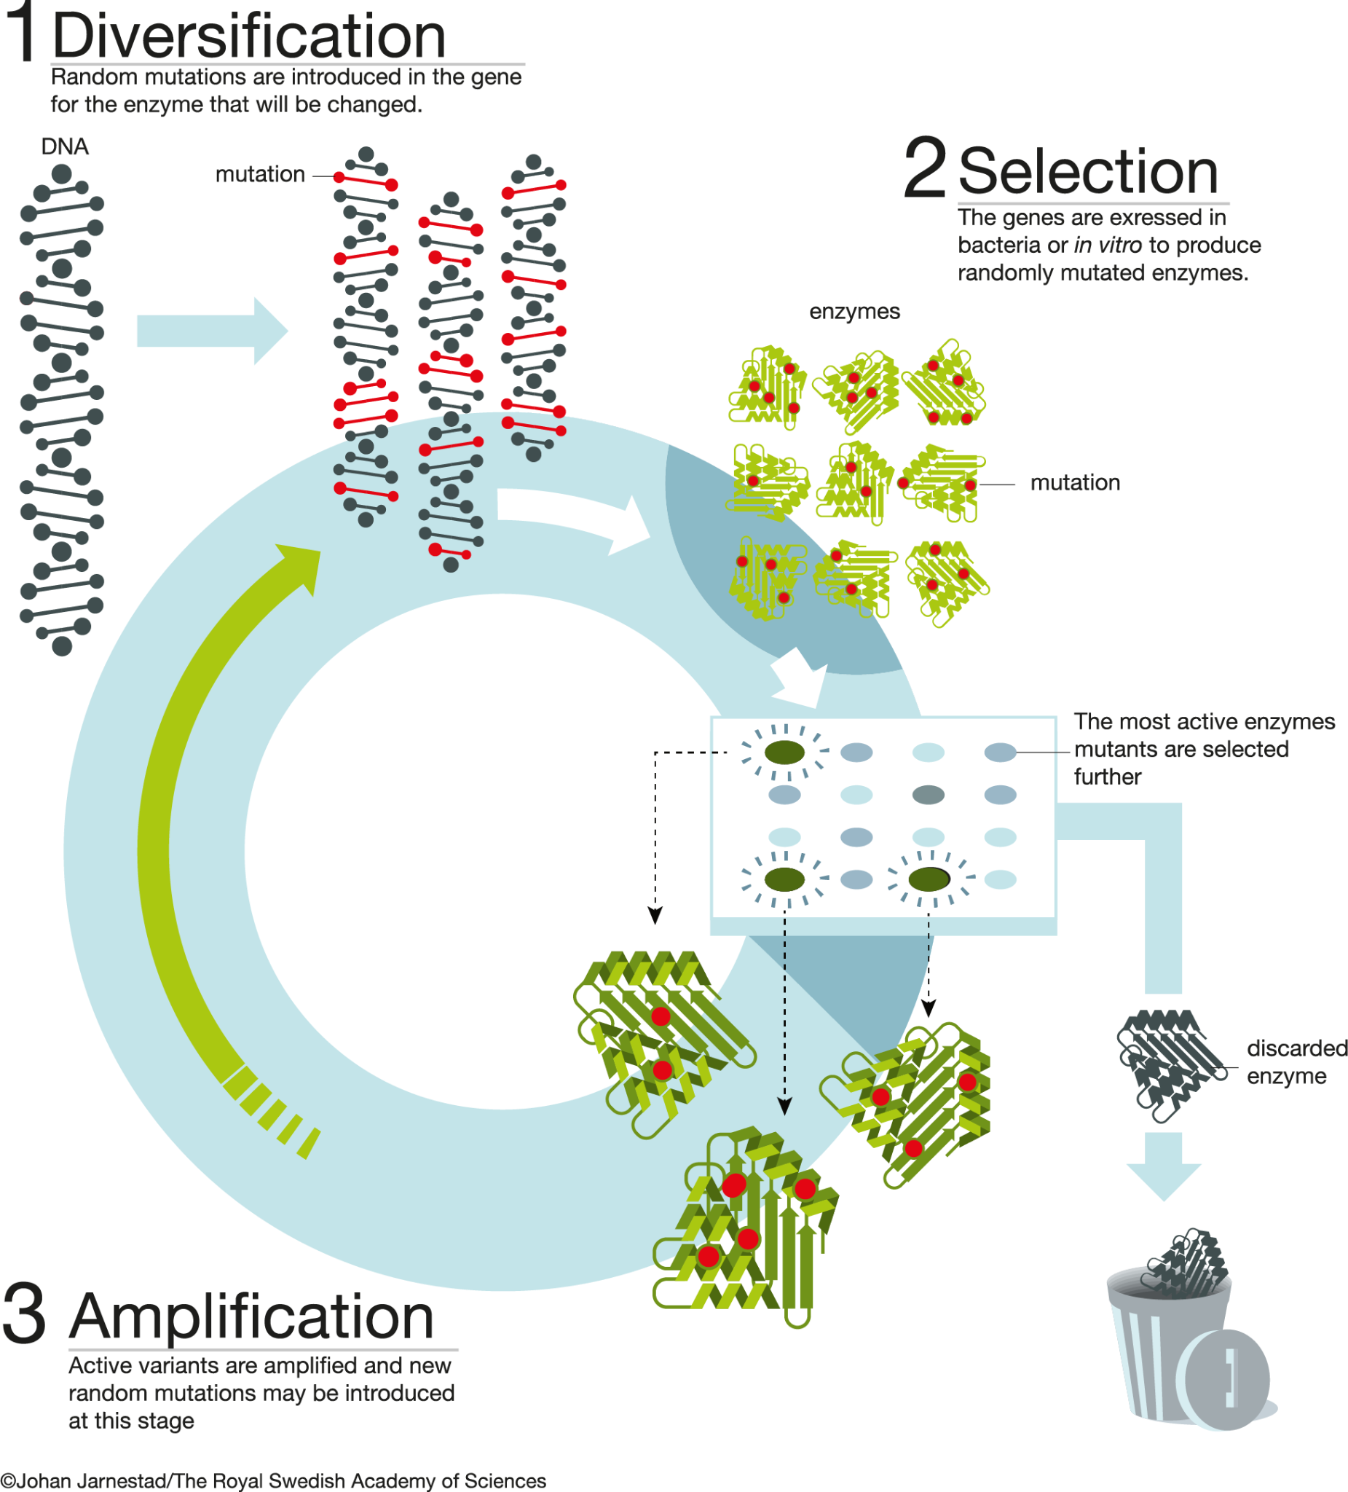
Biomolecular Engineering:
Natural Macromolecules
Natural macromolecules including proteins and RNAs can be engineered to have new properties (e.g., thermostability) or perform new functions (e.g., binding, catalysis)
Directed evolution can be used to tailor the function of proteins through rounds of sequence diversification, selection for function, and amplification of
The Nobel Prize.
Notes:
Image credit: Press release: The Nobel Prize in Chemistry 2018. ©Johan Jarnestad/The Royal Swedish Academy of Sciences

Slide 47
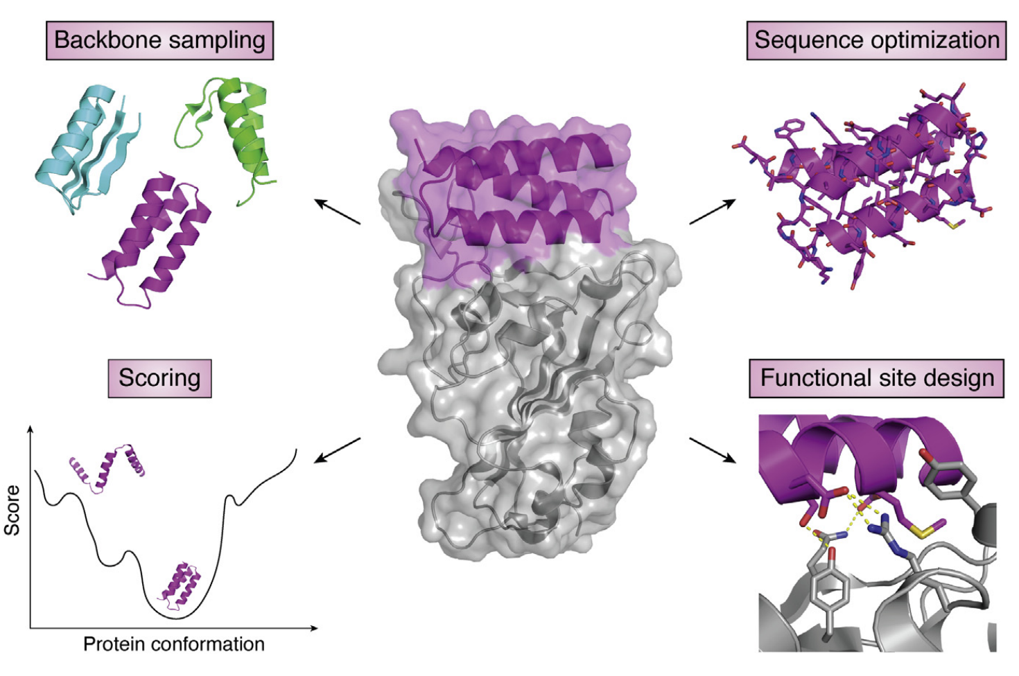
Biomolecular Engineering:
Unnatural Macromolecules
Entirely new protein sequences not seen in nature can be generated through de novo protein design
De novo design enables exploration of protein sequence space beyond what nature has itself explored
Pan X. and Kortemme T. JBC Reviews (2021) 296 100558
Notes:
Image credit: https://doi.org/10.1016/j.jbc.2021.100558

Slide 48
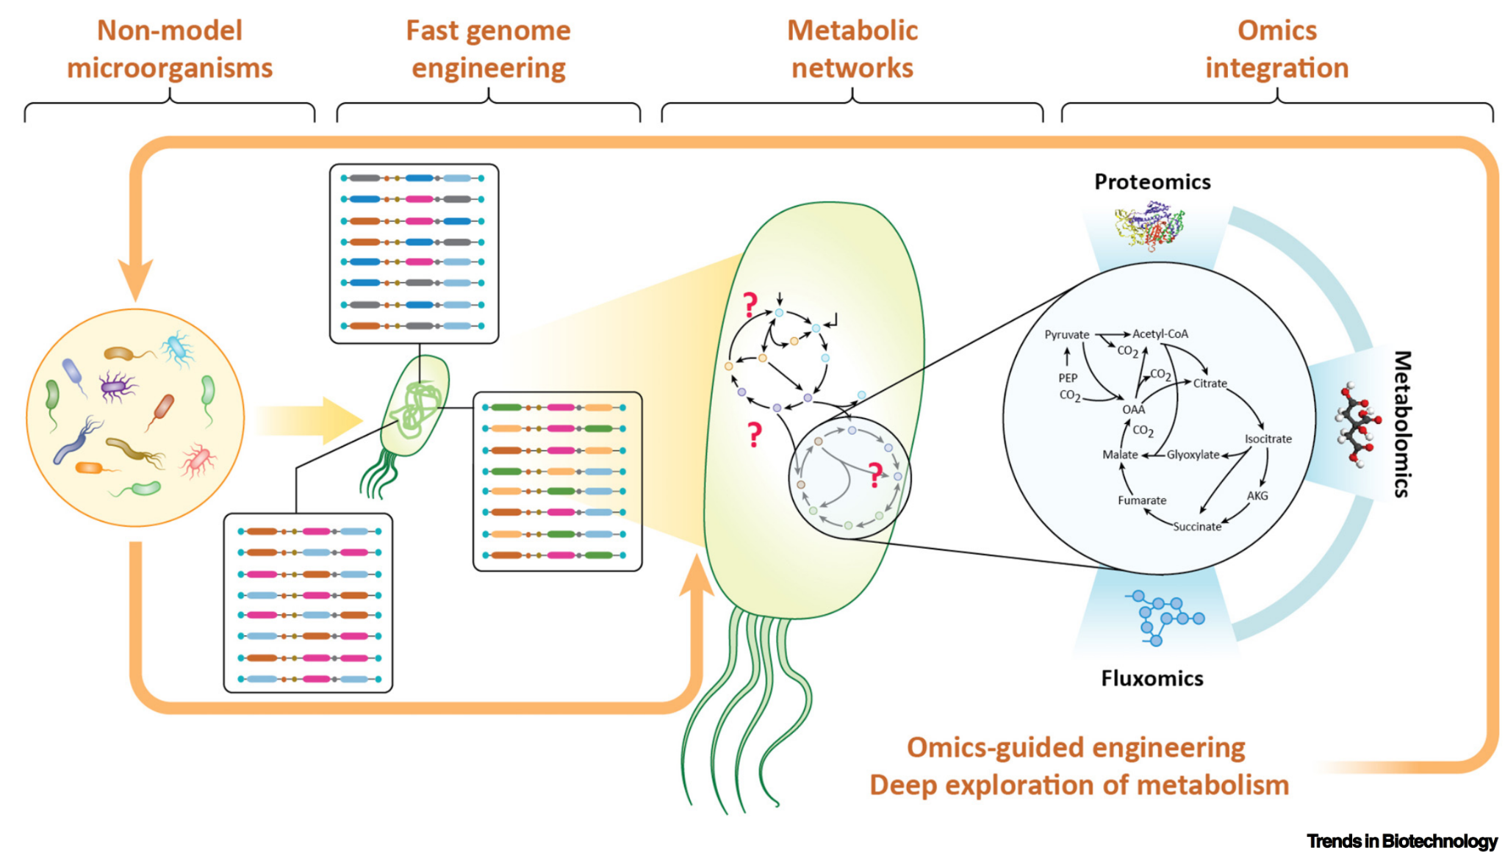
Biomolecular Engineering:
Circuits and Pathways
In addition to individual biomolecules large scale networks of biomolecules
Novel metabolic pathways can be constructed using retrosynthesis approaches
Combinatorial libraries can be used to optimize expression of pathways proteins
Adaptive laboratory evolution can be used to optimize the host genome for improved yield of a target molecule
Gurdo N., Volke D.C., Nikel P.I. (2022) Trends in Biotechnology
Notes:
Image credit: https://doi.org/10.1016/j.tibtech.2022.03.004

Slide 49
Concept 1-4
Core Tools Part 2:
Host Engineering,
Data Science

Slide 50
Core Tools for Host Engineering
What types of hosts are there?
Model & non-model systems
Thinking across scales
Engineering Biology Research Consortium (2019). Engineering Biology: A Research Roadmap for the Next-Generation Bioeconomy. Retrieved from http://roadmap.ebrc.org. doi: 10.25498/E4159B.

Slide 51
Host Engineering
Host choice - what can systems do?
Cell-free
Bacteria
Yeast
Can quickly test gene expression
Grow compounds too taxing for cells
Needs to be extracted, purified
Grows well in bulk
Model for many diseases
Prokaryotic
Can’t fold many human proteins
Grows well in bulk
Can produce a variety of proteins
Often used in foods (i.e. bread)
Created with Biorender.com.
Notes:
Image credit: Created with BioRender.com.

Slide 52
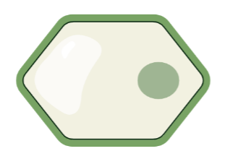
Host Engineering
Host choice - what can systems do?
Mammal
Plant
Whole organism
Human protein folding
Test drug therapies
Difficult to grow in bulk
Photosynthetic
Produce a variety of compounds
Fewer tools available
Increased complexity
Can study phenotypes in vivo
More difficult to engineer at the cell level
Created with Biorender.com.
Notes:
Image credit: Created with BioRender.com.

Slide 53
Host Engineering
“Model organism”: well-studied, often engineering tools available, widely used
When to use a model organism
Maximizing production a compound that can be made in a model system
Looking to use a specific, established tool or platform
A known model organism is a good fit for the project you want to do
When to use a non-model organism
Studying a specific process in its native context
Making complex or unusual proteins
Looking for specific, niche host characteristics

Slide 54
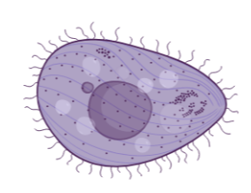
Host Engineering
Example: producing human ion channels in bulk (for crystallography or drug discovery)
If you use a model human cell strain…
Easy to get in correct genes inserted
Difficult to produce in non-neural cells, or large quantities
Cannot grow easily in bulk
If you use non-model Tetrahymena…
More difficult to insert genes
Can produce in large quantities
Can grow in bulk (if you have the specific expertise to work with it)
Created with Biorender.com.
Notes:
Image credit: Created with BioRender.com.

Slide 55
Host Engineering:
Engineering across scale
Very few cells are naturally isolated
Cell tissues and microbial consortia are complex
Often more difficult to engineer
Can carry out complex tasks
Can give better understanding of natural systems
Created with Biorender.com.
Notes:
Image credit: Created with BioRender.com.

Slide 56
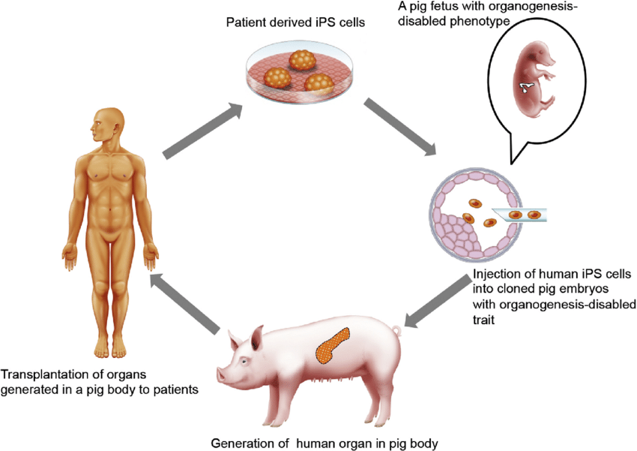
Host Engineering:
Tissue scale
Example: humanized organs in pigs for xenotransplantation
Can edit genes in pigs to prevent human immune rejection
Requires initial transplant of human cells to start
Often use existing systems with some de novo engineered parts
Created with
Biorender.com.
Nagashima & Matsunari. (2016). Theriogenology.
Notes:
Upper image credit: Created with BioRender.com.
Lower image credit:https://www.sciencedirect.com/science/article/pii/S0093691X16300954
https://www.uab.edu/news/research/item/12567-the-10-gene-pig-and-other-medical-science-advances-enabled-uab-s-transplant-of-a-pig-kidney-into-a-brain-dead-human-recipient

Slide 57
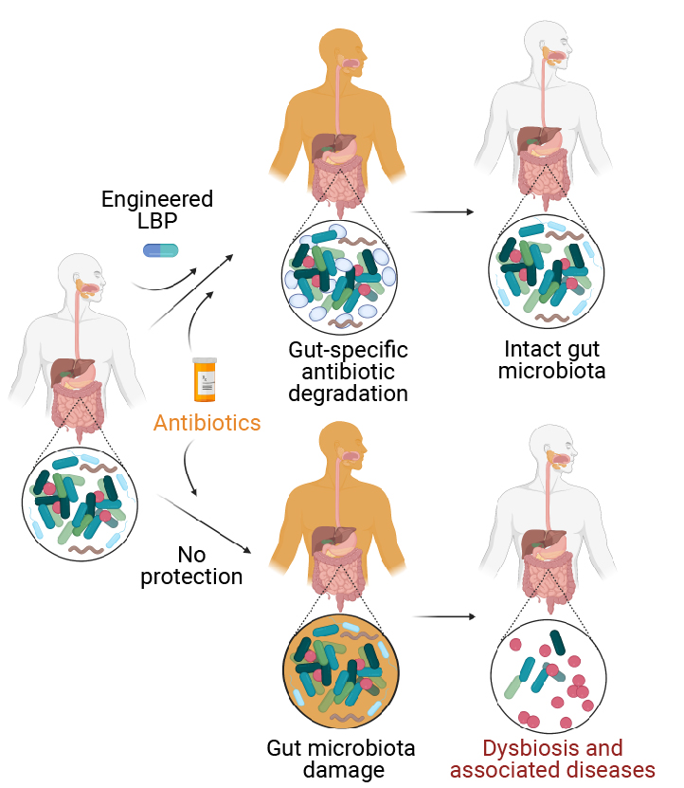
Host Engineering:
Consortia scale
Example: engineered live biotherapeutic products to protect the microbiome from antibiotics
Allows antibiotic to clear pathogen from bloodstream, without harm to native gut microbiota
Specific changes that lead to known broader outcomes
Created with
Biorender.com.
Wyss Institute at Harvard University.
Notes:
Upper image credit: Created with BioRender.com.
Lower image credit: https://wyss.harvard.edu/news/protecting-the-human-intestinal-microbiota-with-synthetic-biology/ Wyss Institute at Harvard University.

Slide 58
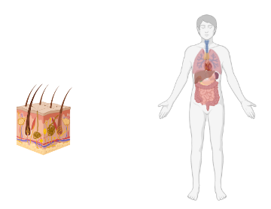
Host Engineering: Engineering across scale
Beyond tissues are organisms
High-level, complex interactions and functions
Often limited to making singular, distinct edits
Beyond consortia are ecosystems
Many consortia and organisms interacting
Potential for “terraforming”
Difficult to recapitulate in lab
Created with Biorender.com.
Notes:
Image credit: Created with BioRender.com.

Slide 59
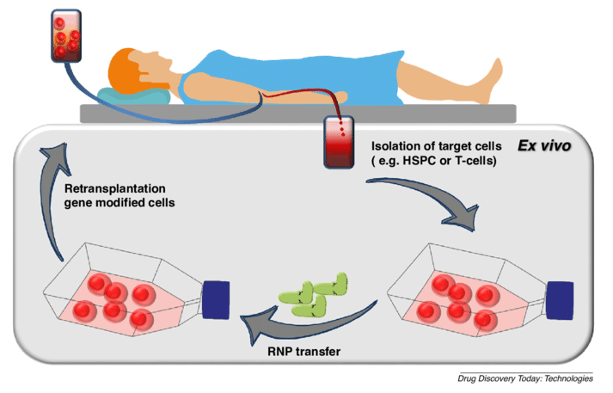
Host Engineering:
Organism scale
Example: use of CRISPR to treat sickle cell anemia
Modification of one codon can revert to non-sickle phenotype
Specific, targeted changes
Sürün, et al. (2018). Drug Discovery Today: Technologies.
Notes:
Image credit: https://doi.org/10.1016/j.ddtec.2018.08.001

Slide 60
Host Engineering:
Ecosystem scale
Example: Using of gene drives to suppress pest populations
Recall introduction!
Also for specific, targeted changes
Created with
Biorender.com.
Mariuswalter, “Gene Drive.”
Notes:
Upper image credit: Created with BioRender.com.
Lower image credit: https://en.wikipedia.org/wiki/Gene_drive#/media/File:Gene_Drive.png

Slide 61
Core Tools for Data Science
What data is out there?
Modeling & Machine Learning
Automation
Engineering Biology Research Consortium (2019). Engineering Biology: A Research Roadmap for the Next-Generation Bioeconomy. Retrieved from http://roadmap.ebrc.org. doi: 10.25498/E4159B.

Slide 62
Data Science:
“Omics data”
Genome
Who is there?
What can they make?
Transcriptome
What are they saying to making?
Proteome
What are they making?
Metabolome
What are they doing?
Species identification
Mutation rate in a population
Gene regulation
Population heterogeneity
RNA regulation
Protein stability & degradation
Metabolic pathway efficiency
Cellular inputs & outputs
Then integrate!
Created with Biorender.com.
Notes:
Image credit: Created with BioRender.com.

Slide 63
Data Science:
Genomics
Why:
Discover members of a large population
Understand the variation between/within populations
Epigenomics: how DNA modifications impact expression
How:
Large-scale sequencing
Reassembly (what pieces are from whom)
Comparing regions of interest (species identifiers, important coding regions)
Created with Biorender.com.
Notes:
Image credit: Created with BioRender.com.

Slide 64
Data Science:
Transcriptomics
Why:
mRNA - what genes are cells expressing under specific conditions
ncRNA - regulation and more
How:
RNA sequencing (similar to DNA-seq)
Microarrays (quantify a set of specific sequences)
Created with Biorender.com.
Notes:
Image credit: Created with BioRender.com.

Slide 65
Data Science:
Proteomics
Why:
Know what proteins make up a cell/tissue
Know if cells are making a product of interest
How:
Immunoassays (antibodies)
Protein purification (pull out and quantify a protein of interest, often through a tag)
Mass spectrometry (look for proteins with known chemical profiles)
Created with Biorender.com.
Notes:
Image credit: Created with BioRender.com.

Slide 66
Data Science:
Metabolomics
Why:
Know what chemical products a cell is making
Quantify signalling molecules or chemical product production
How:
Spectrometry methods (gas/liquid chromatography)
Assays for specific molecules of interest
Created with Biorender.com.
Notes:
Image credit: Created with BioRender.com.

Slide 67
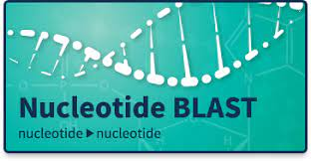
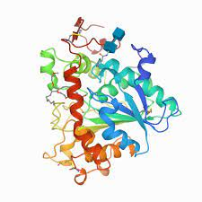
Data Science:
Databases
National Center for Biotechnology Information (NCBI)
GenBank - NIH genetic seq. collection
Nucleotide BLAST - search gene seqs.
UniProt
Protein seq. and functional information
RCSB Protein Database (PDB)
Characterized protein structure and models
Other, more specific DBs:
FPBase - fluorescent protein characterization and lineages

Slide 68
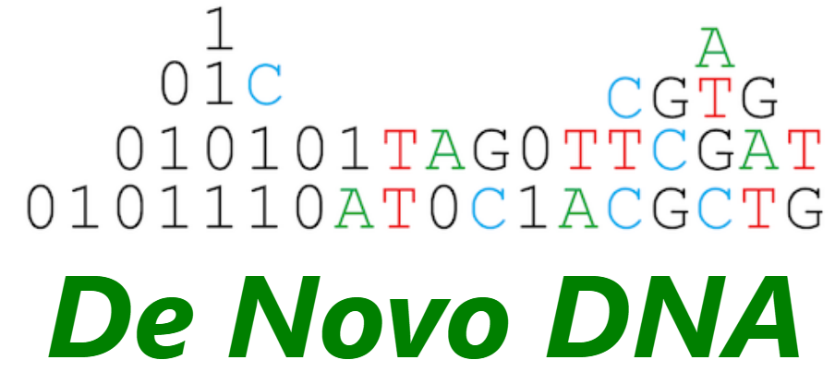
Data Science: Modeling genetic parts
Can use first principles thermodynamics to predict function of parts in some cases
Can integrate larger datasets with machine learning models to make more sophisticated predictions
Predict RBS output based on both RBS and protein sequence

Slide 69
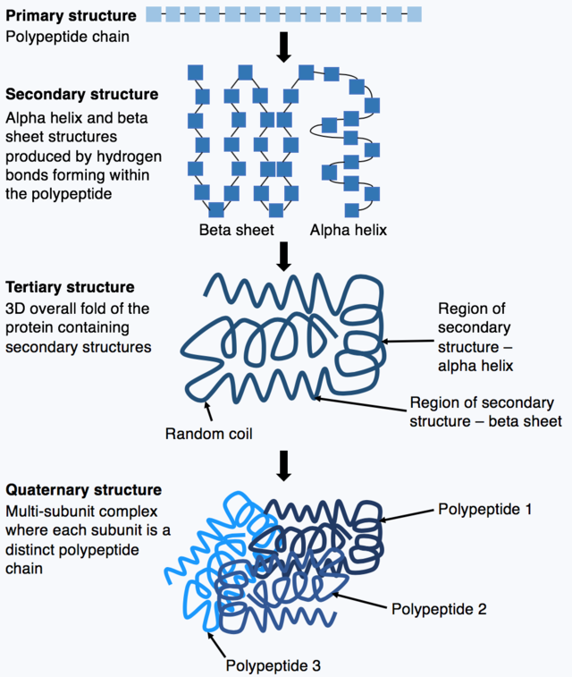
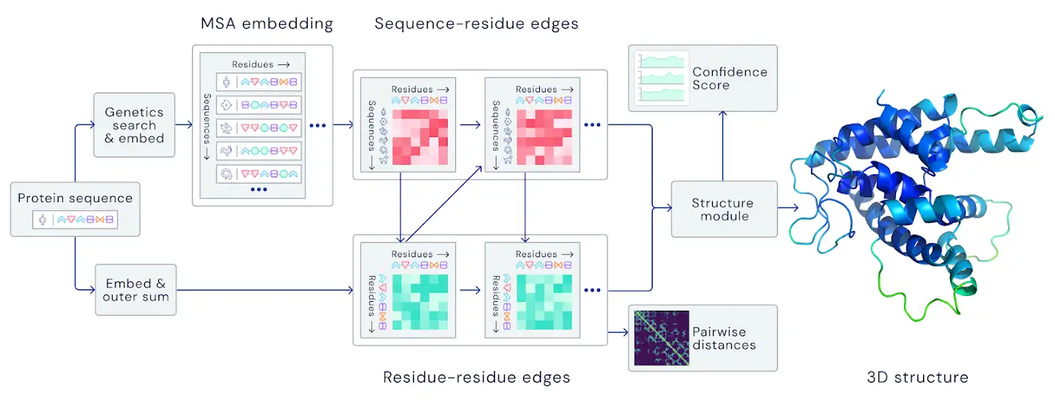
Data Science:
Modeling proteins (AlphaFold)
Kep17, “Amino acid chains.”
DeepMind.
Notes:
From https://en.wikipedia.org/wiki/AlphaFold

Slide 70
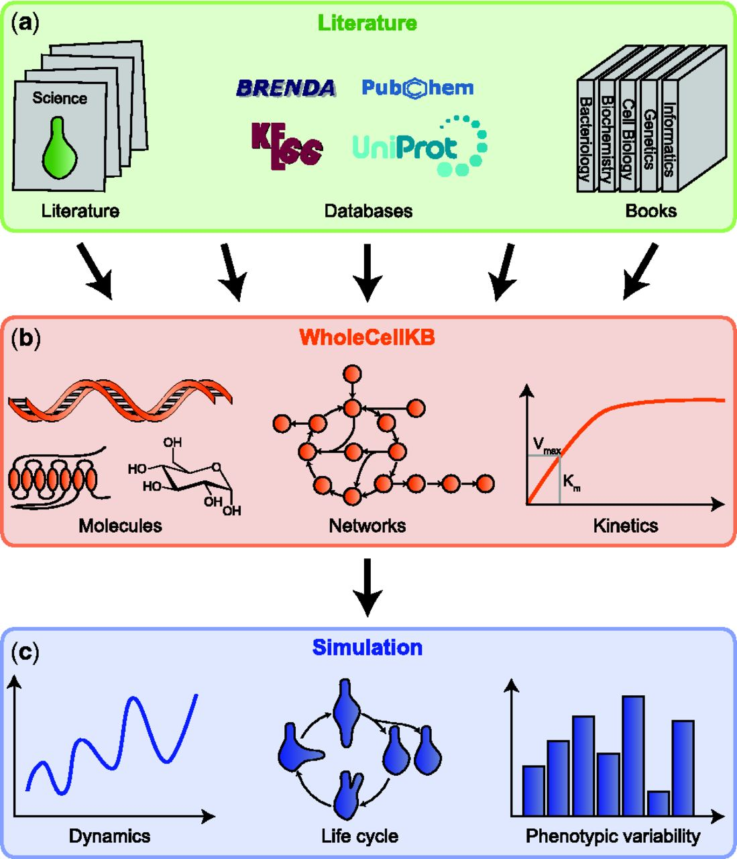
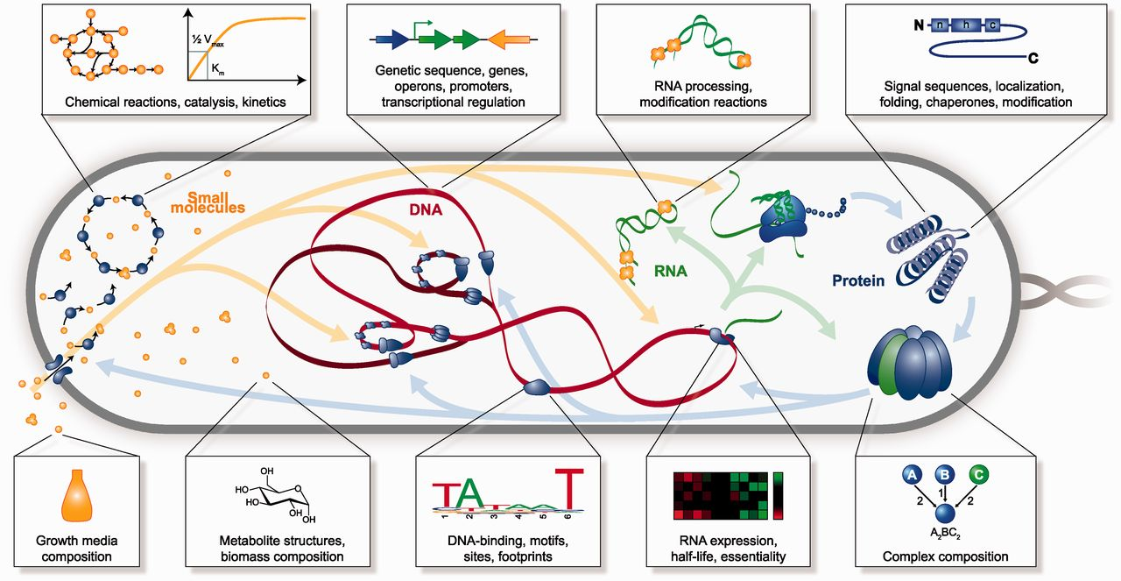
Data Science: Modeling whole systems
Quantify what is there (-omics)
Determine inputs and outputs
Apply equations to determine system functions - metabolic efficiency, protein activity, etc.
NIH: ‘Systems biology is an approach to understand the larger picture—be it at the level of the organism, tissue, or cell—by putting its pieces together. ‘
Karr, et al. (2012). Nucleic acids research.
Notes:
Image credit: https://doi.org/10.1093/nar/gks1108

Slide 71
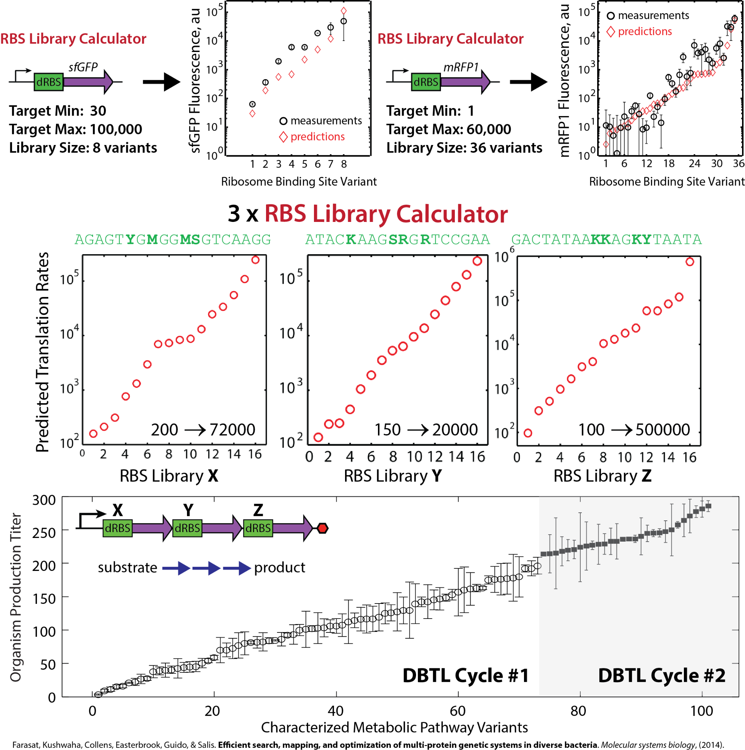
Data Science:
Automation of design
CAD (Computer-Aided Design) of gene constructs
Automation of gene synthesis
De Novo DNA, “RBS Library Calculator.”

Slide 72
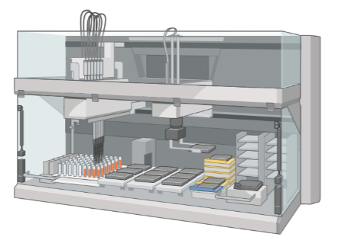
Data Science: Automation of laboratory processes
Liquid handlers to automate Building & Testing genetic constructs
Increase throughput to test multiple constructs simultaneously
Integrated analysis for -omics
Created with Biorender.com.
Notes:
Image credit: Created with Biorender.com.

Slide 73
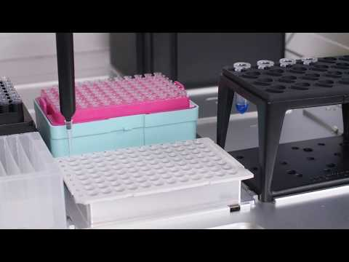
Data Science: Automation of laboratory processes
OpenTrons.
Notes:
https://www.youtube.com/watch?v=I-fzwuJpJBw
Alternate: https://www.youtube.com/watch?v=4C0ElEFK-68&ab_channel=OpentronsLabworks

Slide 74
Concept 1-5
Impacts & Applications

Slide 75
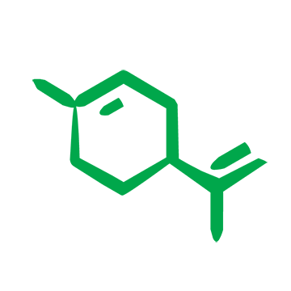
Engineering Biology
Impacts & Applications
We group the impacts of Engineering Biology into five major sectors:
Industrial Biotechnology
Environmental Biotechnology
Food & Agriculture
Health & Medicine
Energy
Engineering Biology Research Consortium (2019). Engineering Biology: A Research Roadmap for the Next-Generation Bioeconomy. Retrieved from http://roadmap.ebrc.org. doi: 10.25498/E4159B.
Notes:
Note: examples for Industrial and Environmental Biotechnology are given in the introduction (slide 7, slide 12)

Slide 76
Food & Agriculture
Microbial symbiont fertilizers
Plants need nitrogen in the soil to grow - often from fertilizer
Current methods to make nitrogen-rich fertilizers use large amounts of energy and have many negative environmental impacts
Some microbes are great at fixing nitrogen - can we engineer microbes to grow on plant roots and fix nitrogen for us?
Notes:
Discussion: environmental concerns of engineered microbes
Other versions: Papaya GMO, artificial meat, plant symbiont/fertilizers

Slide 77
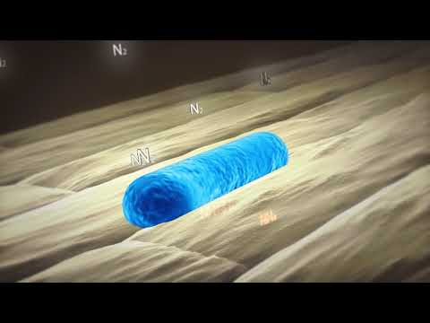
Food & Agriculture
Pivot Bio.
Notes:
Video: https://www.youtube.com/watch?v=bqwDec4MWxo
Discussion: environmental concerns of engineered microbes

Slide 78
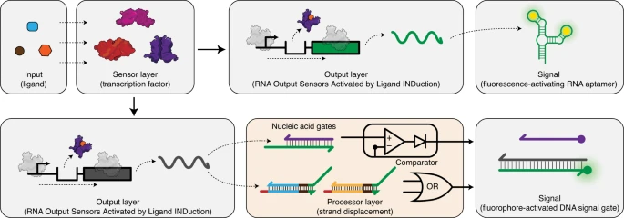
Health & Medicine
At-home water quality testing
Clean water is vital for health - need fast, accurate, affordable assessment
Many possible contaminants (pathogens, heavy metals, pharmaceuticals)
ROSALIND - cell-free diagnostic that combines natural sensor machinery with human-readable fluorescent or colorimetric output of water quality
Jung, J.K., Archuleta, C.M., Alam, K.K. et al. Nat Chem Biol 18, 385–393 (2022).
Notes:
Figure: https://www.nature.com/articles/s41589-021-00962-9
Discussion concerns - accuracy, affordability
Jewett lab rosalind:
http://dx.doi.org/10.1021/acssynbio.9b00347
http://dx.doi.org/10.1038/s41589-021-00962-9
http://dx.doi.org/10.1126/sciadv.aax4473

Slide 79
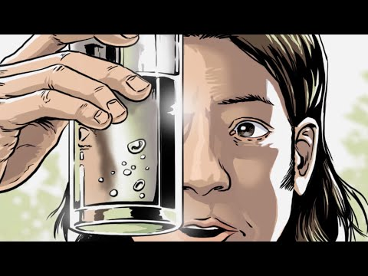
Health & Medicine
Northwestern U.
Notes:
Discussion concerns - accuracy, affordability, treatment access

Slide 80
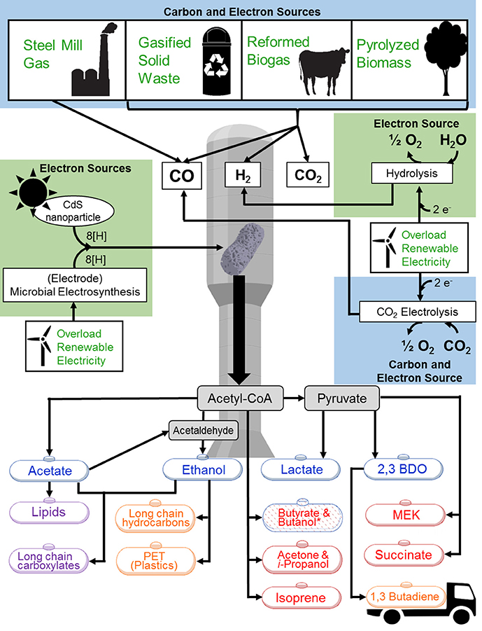
Energy
Carbon-neutral fuels for circular economies
Microbial metabolism can be engineered to turn cells into chemical factories to meet the needs of human resources
Using the core-tools of engineering biology, cells can be engineered to use simple feedstocks like CO2, CO, H2 and turn these into useful products with lower carbon impacts than conventional fossil fuel derived alternatives.
Liew F., et al. (2016) Front. Microbiol. 7:694.

Slide 81
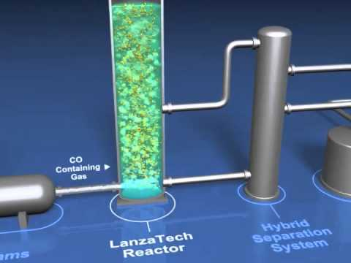
Energy
Carbon-neutral fuels for circular economies
LanzaTech.

Slide 82
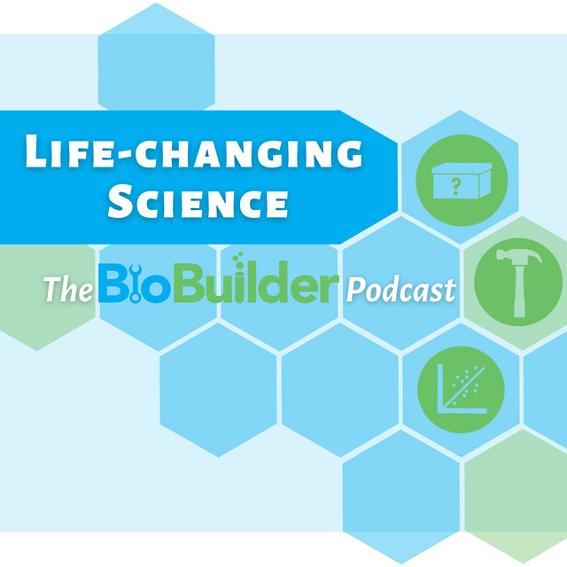
Career Sectors in Engineering Biology
Each sector has its own culture, pacing, and roles
Academia: tenure-track PI, lecturer, core facility manager
Government: national lab scientist, funding agency program manager, admin
Industry: research scientist, customer support, consultant
Between & beyond:
Science communication, journalism
Patent lawyer, tech transfer specialist
Policy, regulations, governance
Explore digital resources:
EBRC In Translation podcast
BioBuilder Life-Changing Science podcast
AAAS myIDP website

Slide 83
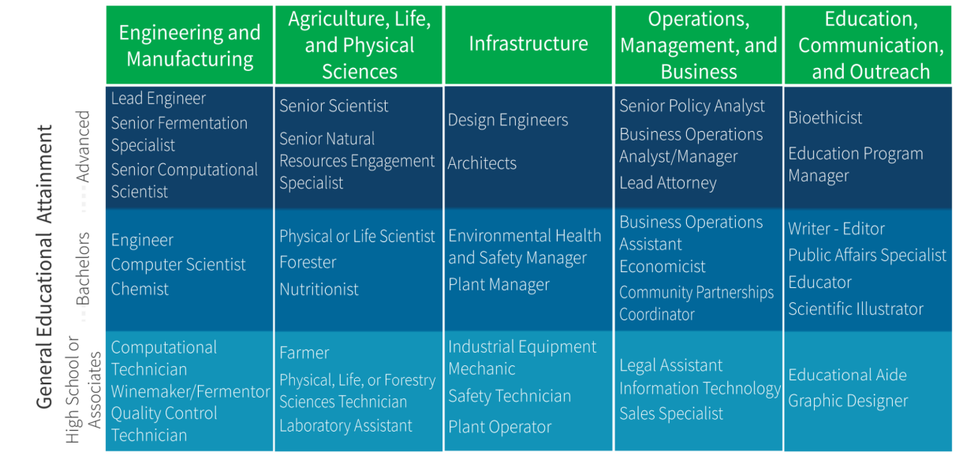
Diverse Careers in Engineering Biology
Hinman, A.W., Friedman, D.C. EBRC. (2022).
Notes:
Albert W. Hinman and Douglas C. Friedman. Actions to Enable an Equitable and Innovative U.S. Bioeconomy. Engineering Biology Research Consortium. 2022. https://doi.org/10.25498/E4X59D

Slide 84
Engineering Biology is driven by a collaborative network of dedicated professionals
Many possible roles:
Bioinformatician in an academic lab who applies data analysis, modeling, and statistics to large datasets to delineate complex biological processes.
Program manager in a government agency who develops and writes research & training initiatives, and discusses research priorities with academic labs.
Biosecurity specialist in a biotech company who coordinates the development and operation of security screening processes.

Slide 85
Summary
Engineering biology:
Uses a DBTL framework
To apply key biology & engineering technologies
For impact in sectors across aspects of life and the planet
Engineering Biology Research Consortium (2019). Engineering Biology: A Research Roadmap for the Next-Generation Bioeconomy. Retrieved from http://roadmap.ebrc.org. doi: 10.25498/E4159B.

Slide 86
Credits
Slides developed by Joshua Atkinson & Michael Sheets.
We thank the EBRC Education Working Group for helpful feedback on the slides, and in particular thanks to Emily Aurand, Kaitlyn Duvall, India Hook-Barnard, Javin Oza, Beth Vitalis, and Michael Jewett.

Slide 87
Figure Credits
6. EBRC. (2019). “Engineering Biology: A Research Roadmap for the Next-Generation Bioeconomy.” (Recurring.)
8. Dabbas, M., & Oza, J. Original graphic created with BioRender.com.
11-14. NIH. (2013). From DNA to Beer: Harnessing Nature in Medicine & Industry. Courtesy of the National Library of Medicine.
16. Dabbas, M., & Oza, J. Original graphic created with BioRender.com.
16, 17, 20, & 60. Marius Walter, “Gene Drive.” Wikimedia.
22. Jewett, M. “Kondratiev Waves.”
26 & 27. Gray, P. et al. (2018). “Synthetic Biology in Australia: An Outlook to 2030.” Australian Council of Learned Academies.
31. Carlson, R. “On DNA and transistors.” Synthesis.
32.Twist Bioscience. (2018). “A Simple Guide to Phosphoramidite Chemistry and How it Fits in Twist Bioscience's Commercial Engine.” SID = 329774846.
33. Dhorspool, “PCA polymerase cycling assembly.” Wikimedia.
34-44. Original graphics by Joshua Atkinson.
46. The Nobel Prize. (2018). “Press release: The Nobel Prize in Chemistry.”
47. Pan, X. and Kortemme, T. (2021). “Recent advances in de novo protein design: Principles, methods, and applications.” JBC Reviews 296:100558
48. Gurdo, N., Volke, D.C., Nikel, P.I. (2022). “Merging automation and fundamental discovery into the design–build–test–learn cycle of nontraditional microbes.” Trends in Biotechnology. doi:10.1016/j.tibtech.2022.03.004
56.Nagashima, H., & Matsunari, H. (2016). “Growing human organs in pigs—A dream or reality?” Theriogenology, 86(1), 422-426.

Slide 88
Figure Credits
57. Boettner, B. (2022). “Protecting the human intestinal microbiome with synthetic biology.” Wyss Institute at Harvard University.
59. Sürün, D., von Melchner, H., & Schnütgen, F. (2018). CRISPR/Cas9 genome engineering in hematopoietic cells. Drug Discovery Today: Technologies, 28, 33-39.
69 left. Kep17, “Amino acid chains.” Wikimedia.
69 right. DeepMind. (2020). “AlphaFold: a solution to a 50-year-old grand challenge in biology.”
70. Karr, J. R., Sanghvi, J. C., Macklin, D. N., Arora, A., & Covert, M. W. (2012). WholeCellKB: model organism databases for comprehensive whole-cell models. Nucleic acids research, 41(D1), D787-D792.
71. De Novo DNA, “RBS Library Calculator.”
73. OpenTrons, “Automating PCR Prep with OT 2 Pipetting Robot.” YouTube.
77. Pivot Bio, “How it Works - Pivot Bio PROVEN 40.” YouTube.
78. Jung, J.K., Archuleta, C.M., Alam, K.K. et al. “Programming cell-free biosensors with DNA strand displacement circuits.” Nat Chem Biol 18, 385–393 (2022).
79. Northwestern University. “Learn how ROSALIND works.” YouTube.
80. Liew F, Martin ME, Tappel RC, Heijstra BD, Mihalcea C and Köpke M (2016) “Gas Fermentation—A Flexible Platform for Commercial Scale Production of Low-Carbon-Fuels and Chemicals from Waste and Renewable Feedstocks.” Front. Microbiol. 7:694.
81. LanzaTech. “The LanzaTech Process.” YouTube.
83. Hinman, A.W., Friedman, D.C.(2022). Actions to Enable an Equitable and Innovative U.S. Bioeconomy. Engineering Biology Research Consortium.

Slide 89
Extended Resources
EBRC video playlist: https://youtube.com/playlist?list=PLf4eUKhxEIurvaNwNSpyXlKf_LoFRlZZm
iBiology Synthetic Biology course: https://www.ibiology.org/playlists/synthetic-biology/
Raj Lab Synbio Transcript course: https://youtu.be/3xJI8j7YlrI
EBRC Synthetic Biology & Machine Learning series: https://ebrc.org/synbio-ml-education/
CalTech Biomolecular Feedback Systems resource: http://www.cds.caltech.edu/~murray/BFSwiki/index.php
Ben Thuronyi Designing and Building Synthetic Biology Constructs resource: http://bit.ly/synbioguide or https://docs.google.com/document/d/1k3H1xBC_gu_F0B6lPPZeSilcfYtxn4o7bkbBUT_McTc/edit
BioBuilder courses and content: https://biobuilder.org/
Paper: Dymond JS, et al. (2009). Teaching synthetic biology, bioinformatics and engineering to undergraduates: the interdisciplinary Build-a-Genome course. Genetics, 181(1), 13-21. https://doi.org/10.1534/genetics.108.096784
Paper: Williams LC et al. (2020). The genetic code kit: an open-source cell-free platform for biochemical and biotechnology education. Frontiers in bioengineering and biotechnology, 8, 941. https://doi.org/10.3389/fbioe.2020.00941

